Slide 1
Chapter 16 Standard Library Algorithms
C++ How to Program, 9/e

Slide 2
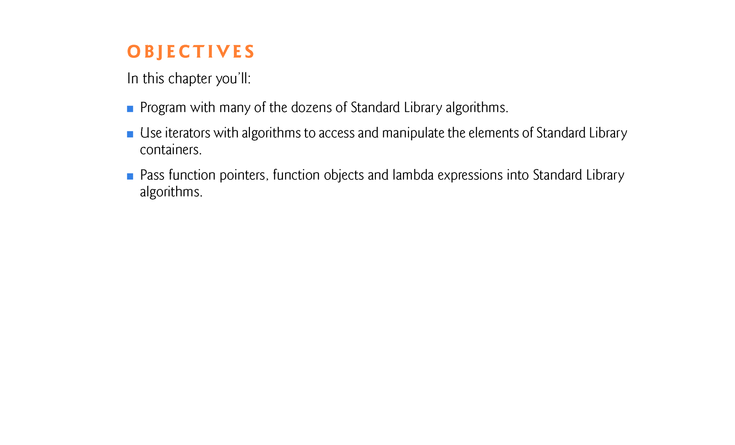

Slide 3
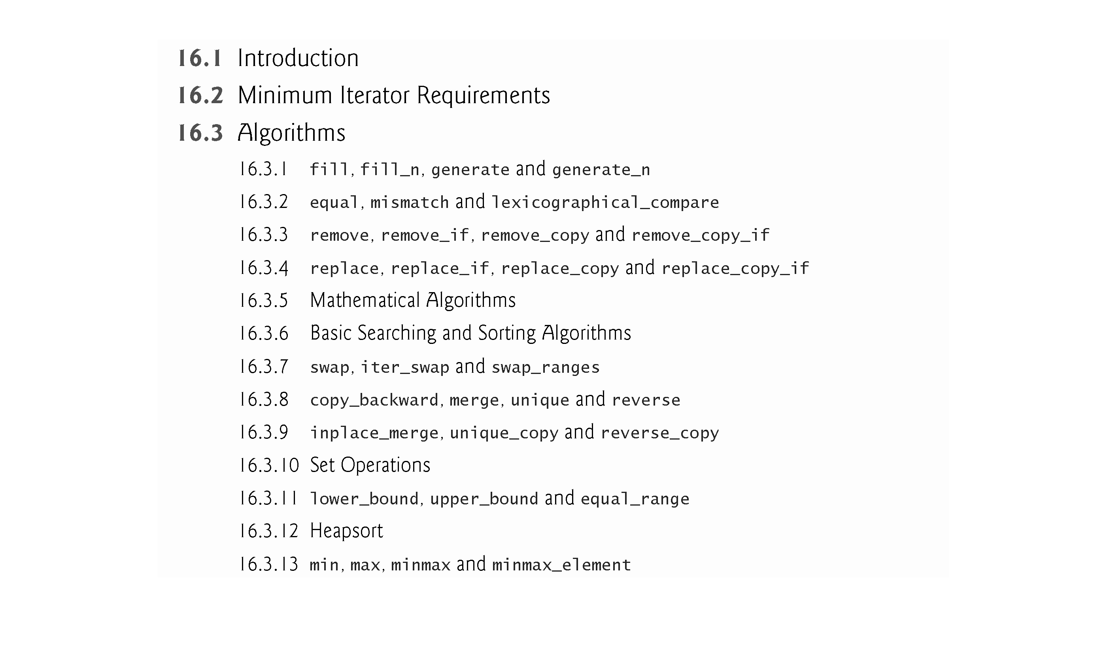

Slide 4
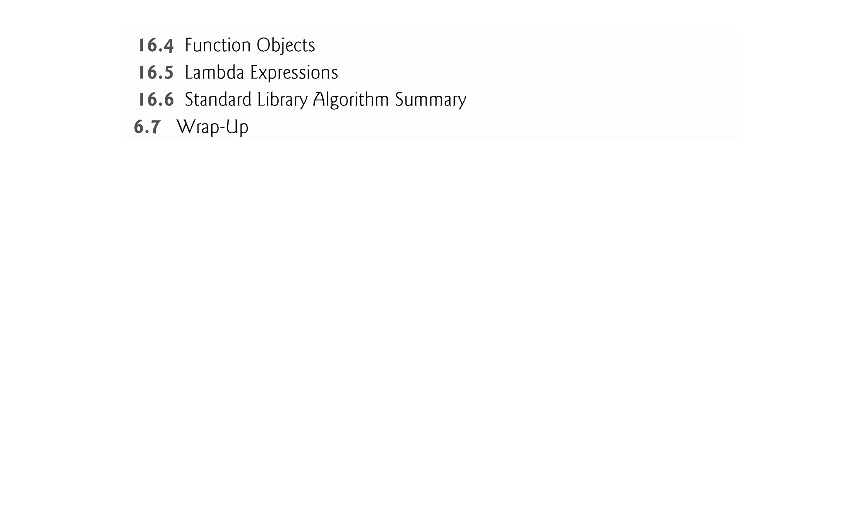

Slide 5
16.1 Introduction
This chapter continues our discussion of the Standard Library’s containers, iterators and algorithms by focusing on algorithms that perform common data manipulations such as searching, sorting and comparing elements or entire containers.
The Standard Library provides over 90 algorithms, many of which are new in C++11.
Most of them use iterators to access container elements.
As you’ll see, various algorithms can receive a function pointer (a pointer to a function’s code) as an argument.
Such algorithms use the pointer to call the function—typically with one or two container elements as arguments.

Slide 6
16.2 Minimum Iterator Requirements
With few exceptions, the Standard Library separates algorithms from containers.
An important part of every container is the type of iterator it supports (Fig. 15.7).
This determines which algorithms can be applied to the container.
For example, both vectors and arrays support random-access iterators that provide all of the iterator operations shown in Fig. 15.9.
All Standard Library algorithms can operate on vectors and the ones that do not modify a container’s size can also operate on arrays.

Slide 7
16.2 Minimum Iterator Requirements (cont.)
Each Standard Library algorithm that takes iterator arguments requires those iterators to provide a minimum level of functionality.
If an algorithm requires a forward iterator, for example, that algorithm can operate on any container that supports forward iterators, bidirectional iterators or random-access iterators.

Slide 8
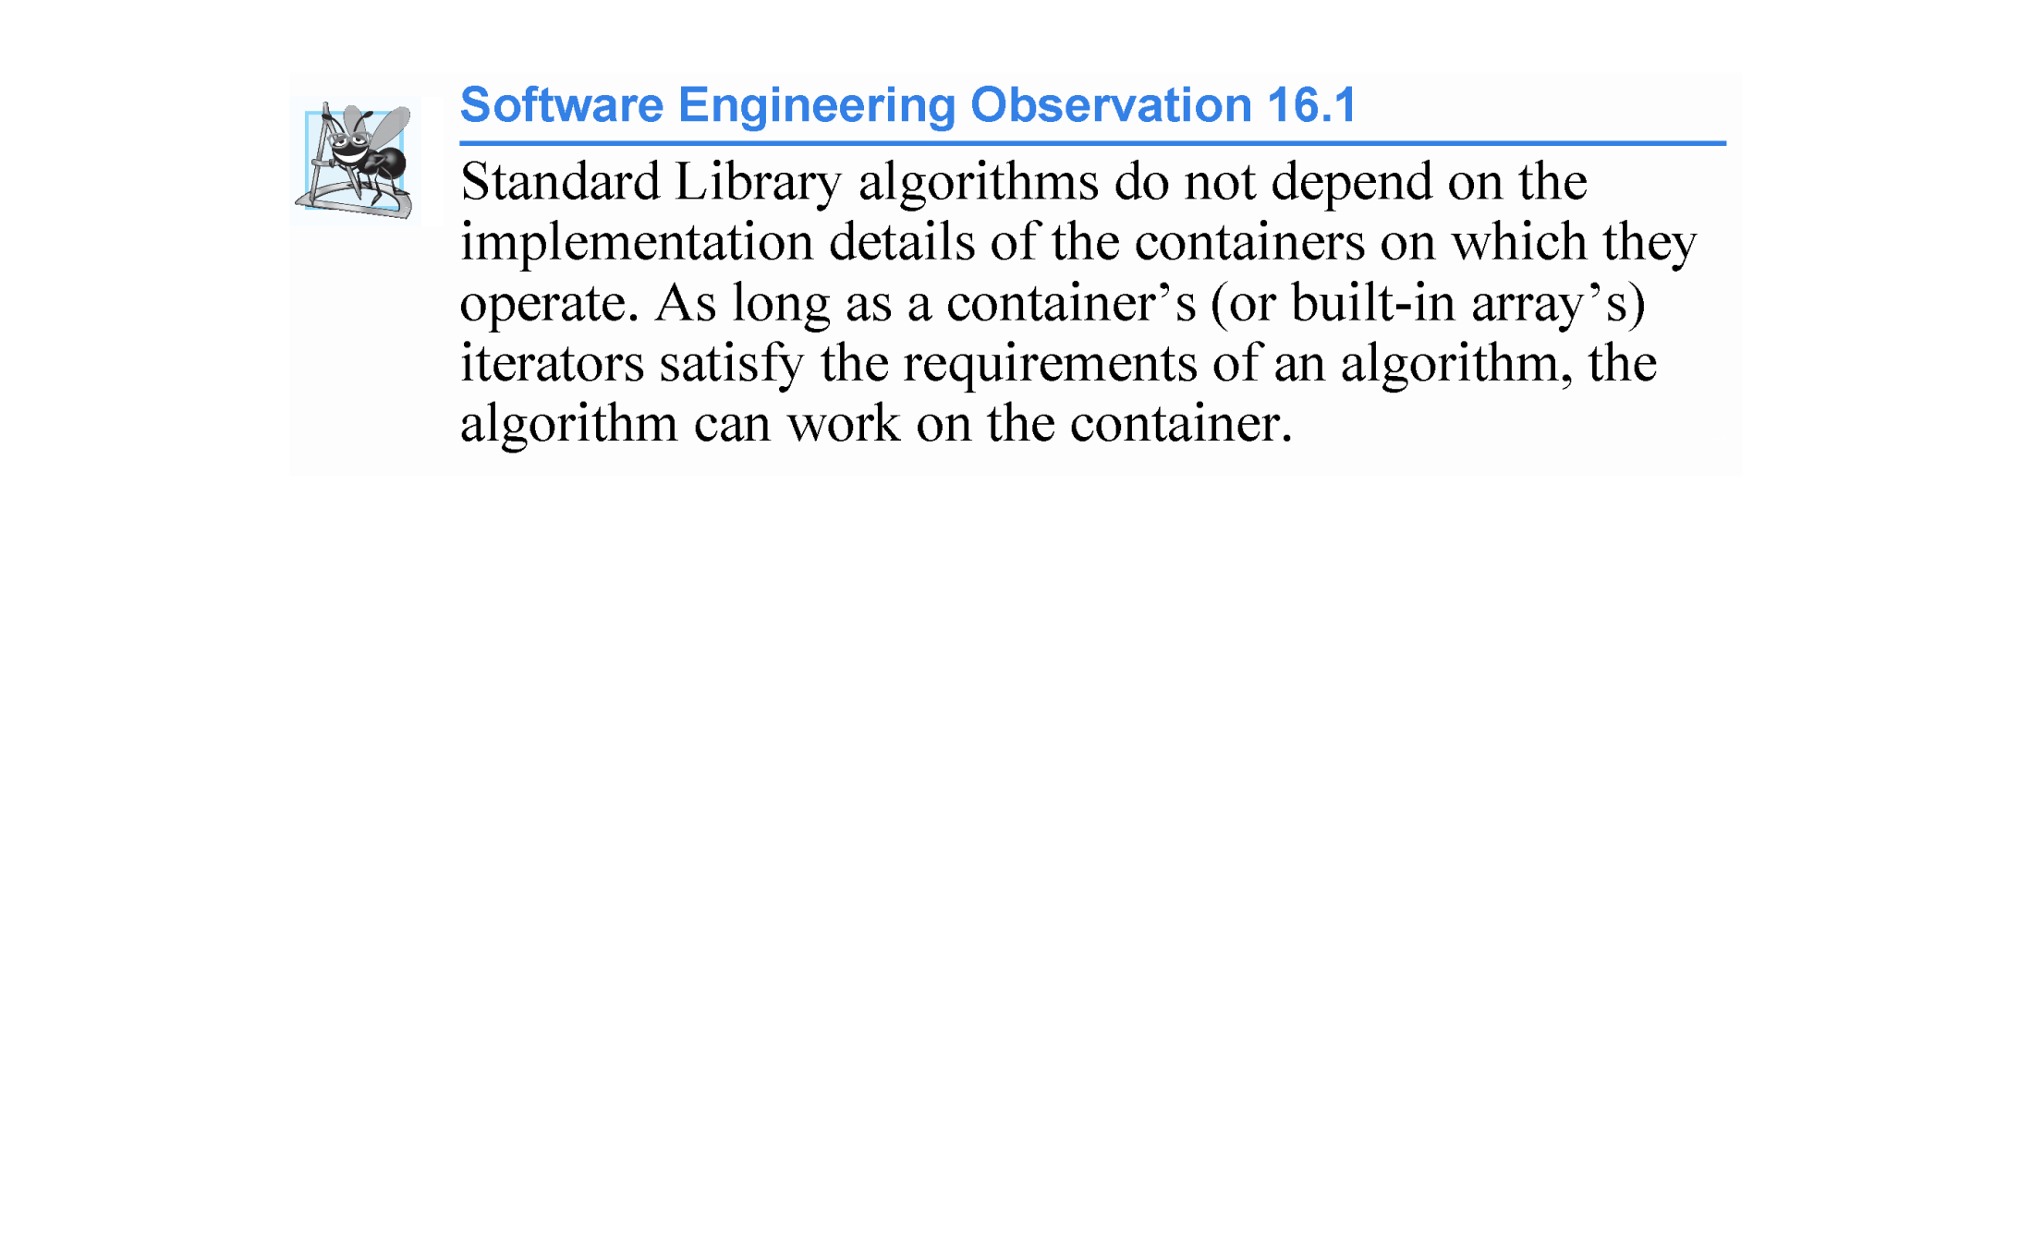

Slide 9
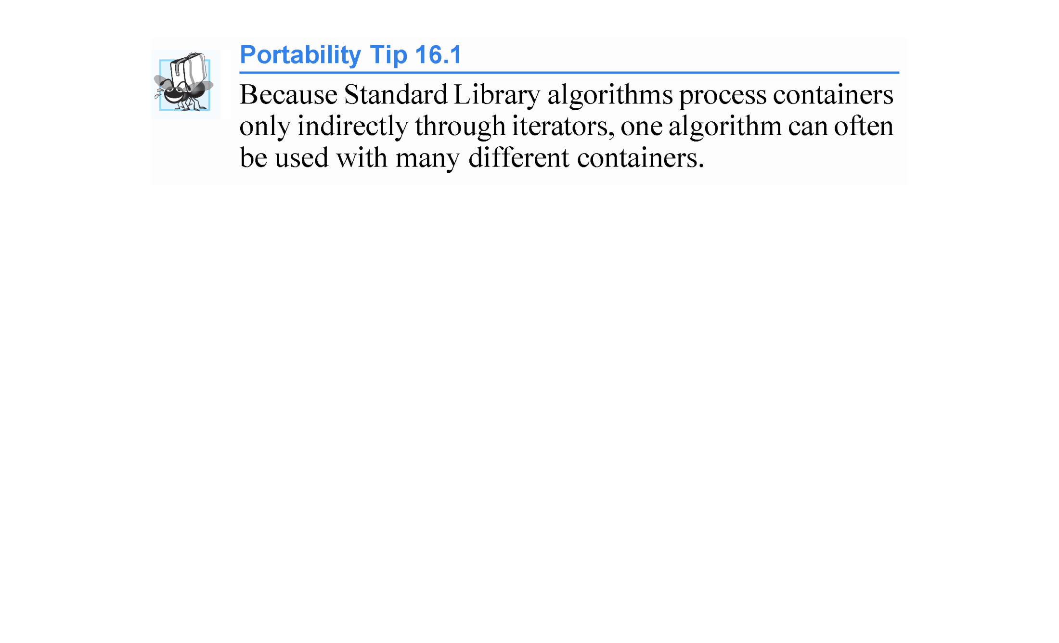

Slide 10
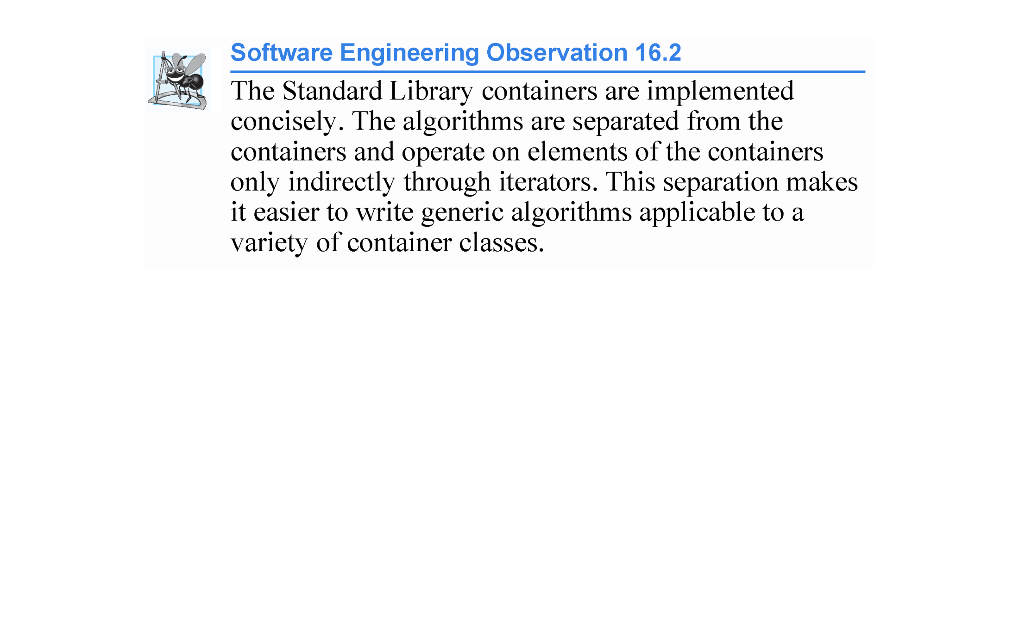

Slide 11
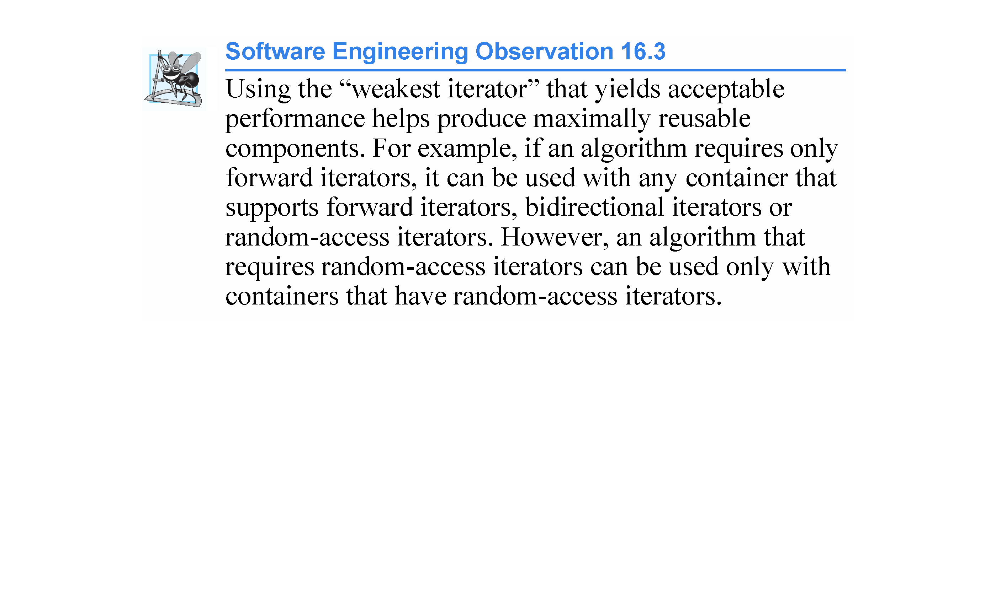

Slide 12
16.2 Minimum Iterator Requirements (cont.)
Iterator Invalidation
Iterators simply point to container elements, so it’s possible for iterators to become invalid when certain container modifications occur.
For example, if you invoke clear on a vector, all of its elements are removed.
If a program had any iterators that pointed to that vector’s elements before clear was called, those iterators would now be invalid.

Slide 13
16.2 Minimum Iterator Requirements (cont.)
Here we summarize when iterators are invalidated during insert and erase operations.
When inserting into a:
vector—If the vector is reallocated, all iterators pointing to that vector are invalidated. Otherwise, iterators from the insertion point to the end of the vector are invalidated.
deque—All iterators are invalidated.
list or forward_list—All iterators remain valid.
Ordered associative container—All iterators remain valid.
Unordered associative container—All iterators are invalidated if the containers need to be reallocated.

Slide 14
16.2 Minimum Iterator Requirements (cont.)
When erasing from a container, iterators to the erased elements are invalidated. In addition:
vector—Iterators from the erased element to the end of the vector are invalidated.
deque—If an element in the middle of the deque is erased, all iterators are invalidated.

Slide 15
16.3 Algorithms
Sections 16.3.1–16.3.13 demonstrate many of the Standard Library algorithms.

Slide 16
16.3.1 fill, fill_n, generate and generate_n
Figure 16.1 demonstrates algorithms fill, fill_n, generate and generate_n.
Algorithms fill and fill_n set every element in a range of container elements to a specific value.
Algorithms generate and generate_n use a generator function to create values for every element in a range of container elements.
The generator function takes no arguments and returns a value that can be placed in an element of the container.

Slide 17
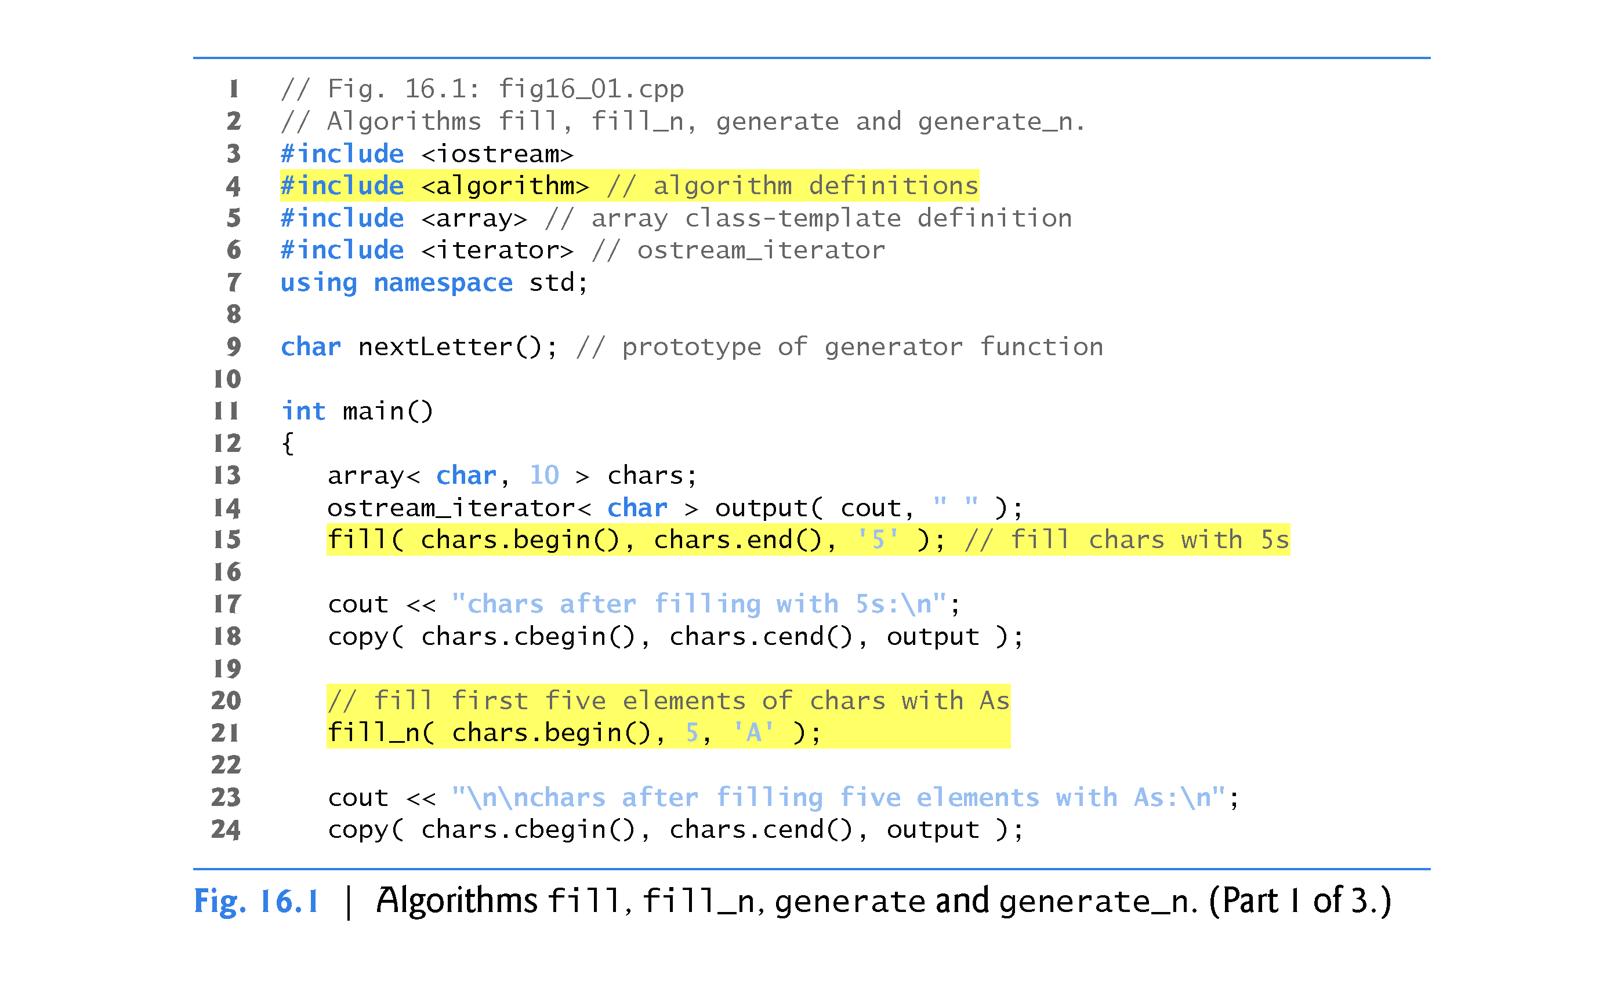

Slide 18
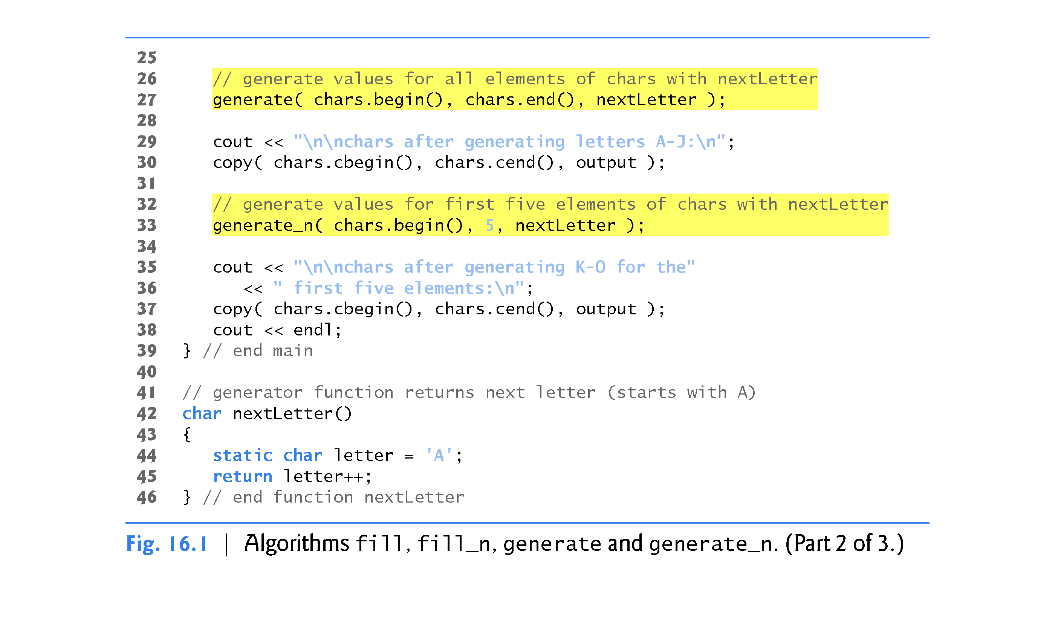

Slide 19
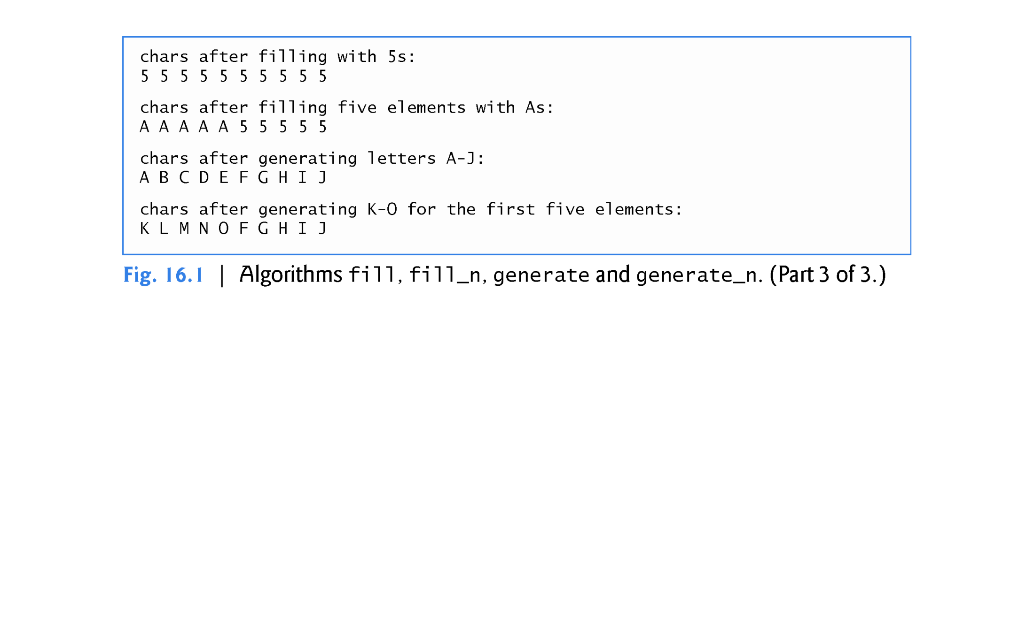

Slide 20
16.3.1 fill, fill_n, generate and generate_n (Cont.)
fill Algorithm
Line 13 defines a 10-element array of char values.
Line 15 uses the fill algorithm to place the character '5' in every element of chars from chars.begin() up to, but not including, chars.end().
The iterators supplied as the first and second argument must be at least forward iterators (i.e., they can be used for both input from a container and output to a container in the forward direction).

Slide 21
16.3.1 fill, fill_n, generate and generate_n (Cont.)
fill_n Algorithm
Line 21 uses the fill_n algorithm to place the character 'A' in the first five elements of vector chars.
The iterator supplied as the first argument must be at least an output iterator (i.e., it can be used to write into a container in the forward direction).
The second argument specifies the number of elements to fill.
The third argument specifies the value to place in each element.

Slide 22
16.3.1 fill, fill_n, generate and generate_n (Cont.)
generate Algorithm
Line 27 uses the generate algorithm to place the result of a call to generator function next-Letter in every element of vector chars from chars.begin() up to, but not including, chars.end().
The iterators supplied as the first and second arguments must be at least forward iterators.
Function nextLetter (lines 42–46) begins with the character 'A' maintained in a static local variable.
The statement in line 45 postincrements the value of letter and returns the old value of letter each time next-Letter is called.

Slide 23
16.3.1 fill, fill_n, generate and generate_n (Cont.)
Generate_n Algorithm
Line 33 uses the generate_n algorithm to place the result of a call to generator function nextLetter in five elements of vector chars, starting from chars.begin().
The iterator supplied as the first argument must be at least an output iterator.

Slide 24
16.3.1 fill, fill_n, generate and generate_n (Cont.)
A Note About Reading Standard Library Algorithm Documentation
When you look at the Standard Library algorithms documentation for algorithms that can receive function pointers as arguments, you’ll notice in the documentation that the corresponding parameters do not show pointer declarations.
Such parameters can actually receive as arguments function pointers, function objects (Section 16.4) or lambda expressions (Section 16.5).
For this reason, the Standard Library declares such parameters using more generic names.

Slide 25
16.3.1 fill, fill_n, generate and generate_n (Cont.)
For example, the generate algorithm’s prototype is listed in the C++ standard document as:
template<class ForwardIterator, class Generator>
void generate(ForwardIterator first, ForwardIterator last,
Generator gen);
indicating that generate expects as arguments ForwardIterators representing the range of elements to process and a Generator function.
The standard explains that the algorithm calls the Generator function to obtain a value for each element in the range specified by the ForwardIterators.
The standard also specifies that the Generator must take no arguments and return a value of the element type.

Slide 26
16.3.2 equal, mismatch and lexicographical_compare
Figure 16.2 demonstrates comparing sequences of values for equality using algorithms equal, mismatch and lexicographical_compare.

Slide 27
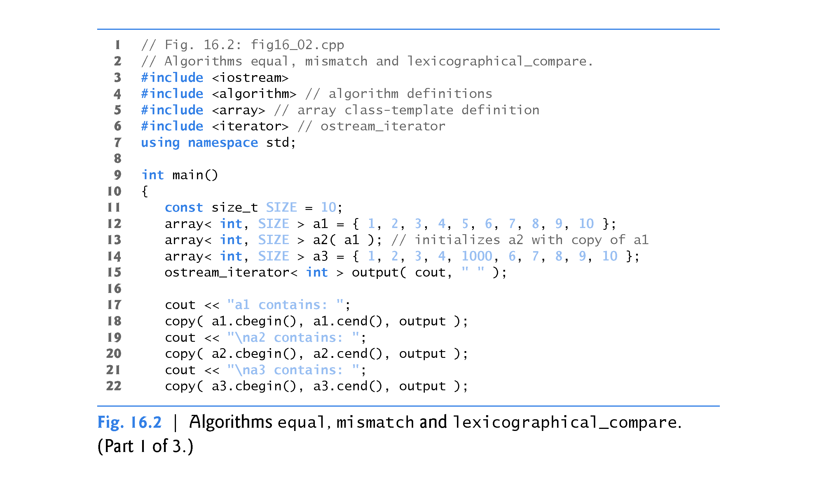

Slide 28
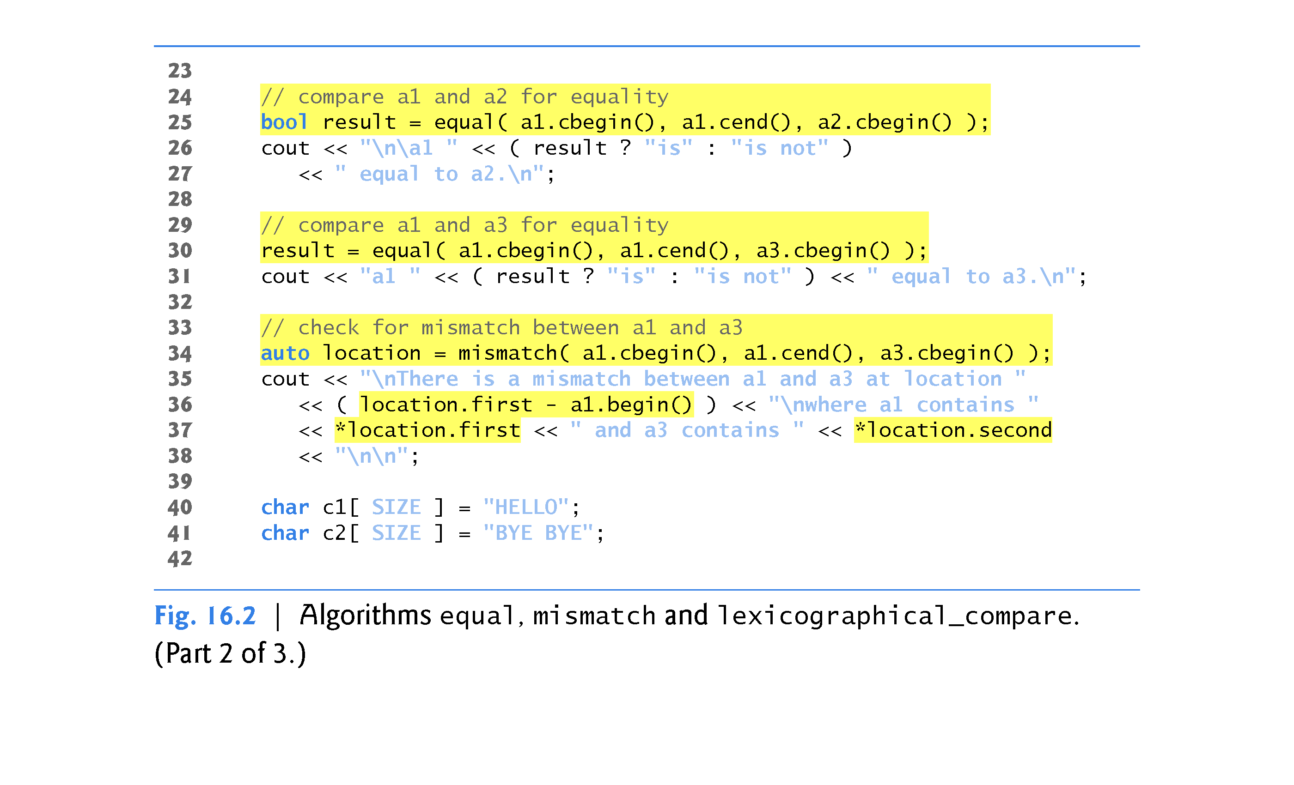

Slide 29
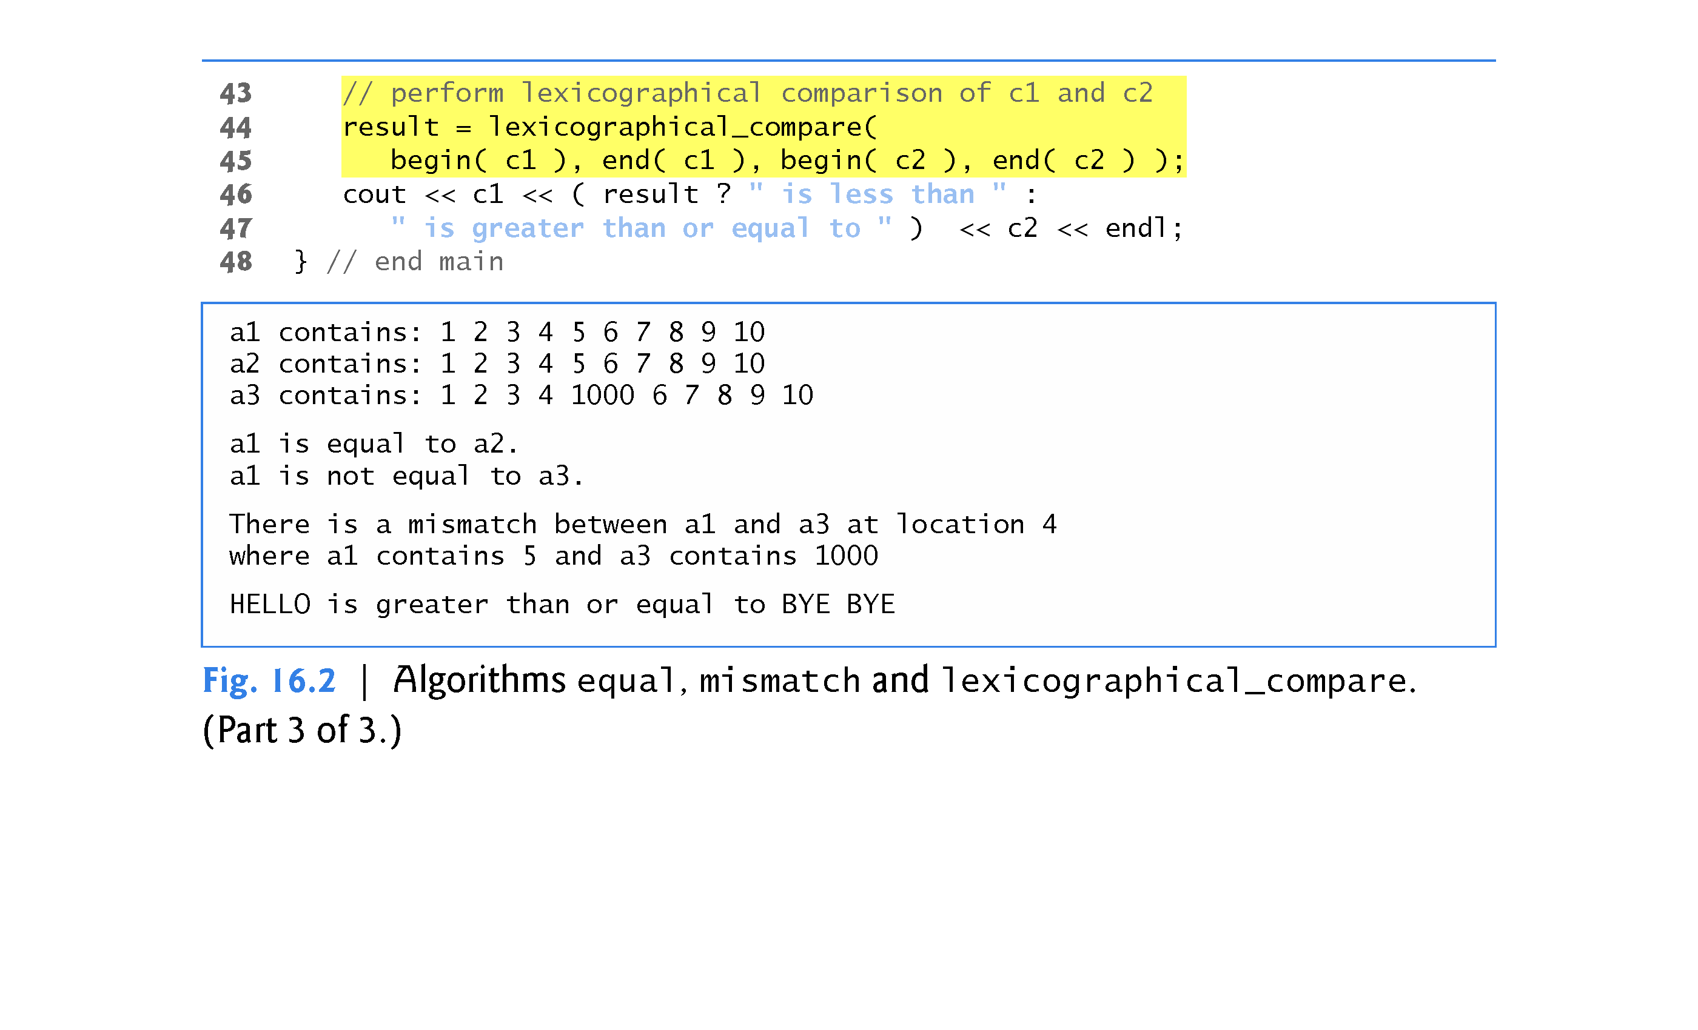

Slide 30
16.3.2 equal, mismatch and lexicographical_compare (Cont.)
equal Algorithm
Line 25 uses the equal algorithm to compare two sequences of values for equality.
The second sequence must contain at least as many elements as the first—equal returns false if the sequences are not of the same length.
The == operator (whether built-in or overloaded) performs the element comparisons.
In this example, the elements in a1 from a1.cbegin() up to, but not including, a1.cend() are compared to the elements in a2 starting from a2.cbegin().
In this example, they are equal.

Slide 31
16.3.2 equal, mismatch and lexicographical_compare (Cont.)
The three iterator arguments must be at least input iterators (i.e., they can be used for input from a sequence in the forward direction).
Line 30 uses function equal to compare a1 and a3, which are not equal.

Slide 32
16.3.2 equal, mismatch and lexicographical_compare (Cont.)
equal Algorithm with Binary Predicate Function
Another version of equal takes a binary predicate function as a fourth parameter.
The binary predicate function receives the two elements being compared and returns a bool value indicating whether the elements are equal.
This can be useful in sequences that store objects or pointers to values rather than actual values, because you can define one or more comparisons.
For example, you can compare Employee objects for age, social security number, or location rather than comparing entire objects.
You can compare what pointers refer to rather than comparing the pointer values (i.e., the addresses stored in the pointers).

Slide 33
16.3.2 equal, mismatch and lexicographical_compare (Cont.)
mismatch Algorithm
Line34 calls the mismatch algorithm to compare two sequences of values.
The algorithm returns a pair of iterators indicating the location in each sequence of the mismatched elements.
If all the elements match, the two iterators in the pair are equal to the end iterator for each sequence.
The three iterator arguments must be at least input iterators.
We infer the type of the pair object location with C++11’s auto keyword (line 34).

Slide 34
16.3.2 equal, mismatch and lexicographical_compare (Cont.)
Line 36 determines the actual location of the mismatch in the arrays with the expression location.first - a1.begin(), which evaluates to the number of elements between the iterators (this is analogous to pointer arithmetic; Chapter 8).
This corresponds to the element number in this example, because the comparison is performed from the beginning of each array.
As with equal, there is another version of mismatch that takes a binary predicate function as a fourth parameter.

Slide 35
16.3.2 equal, mismatch and lexicographical_compare (Cont.)
lexicographical_compare Algorithm
Lines 44-45 use the lexicographical_compare algorithm to compare the contents of two char built-in arrays.
This algorithm’s four iterator arguments must be at least input iterators.
As you know, pointers into built-in arrays are random-access iterators.
The first two iterator arguments specify the range of locations in the first sequence.
The last two specify the range of locations in the second sequence.

Slide 36
16.3.2 equal, mismatch and lexicographical_compare (Cont.)
Once again, we use the C++11 begin and end functions to determine the range of elements for each built-in array.
While iterating through the sequences, the lexicographical_compare checks if the element in the first sequence is less than the corresponding element in the second sequence.
If so, the algorithm returns true.
If the element in the first sequence is greater than or equal to the element in the second sequence, the algorithm returns false.
This algorithm can be used to arrange sequences lexicographically.
Typically, such sequences contain strings.

Slide 37
16.3.3 remove, remove_if, remove_copy and remove_copy_if
Figure 16.3 demonstrates removing values from a sequence with algorithms remove, remove_if, remove_copy and remove_copy_if.

Slide 38
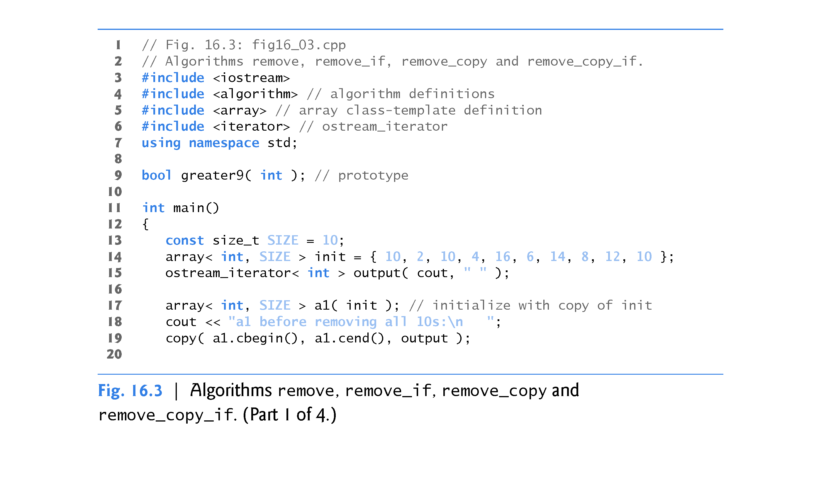

Slide 39
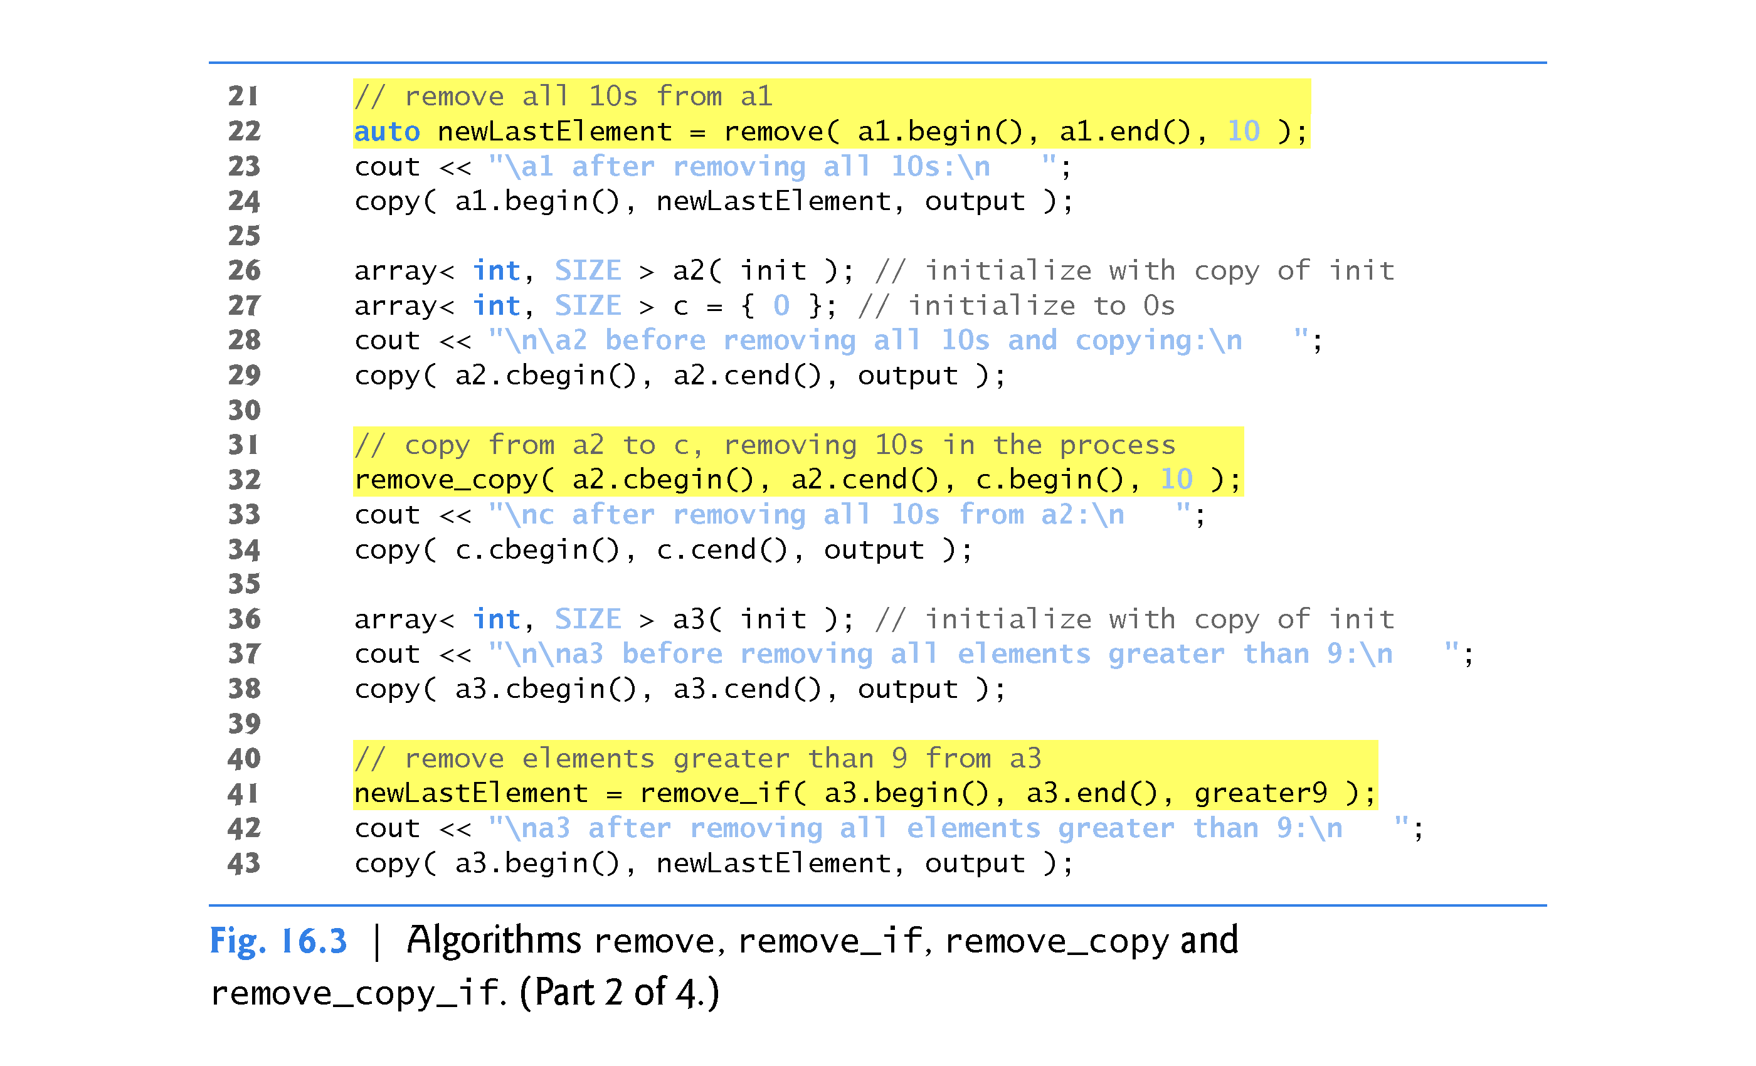

Slide 40
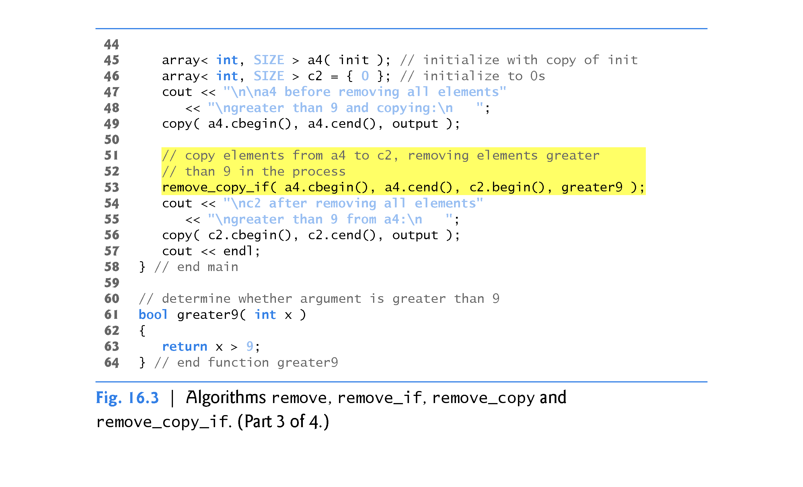

Slide 41
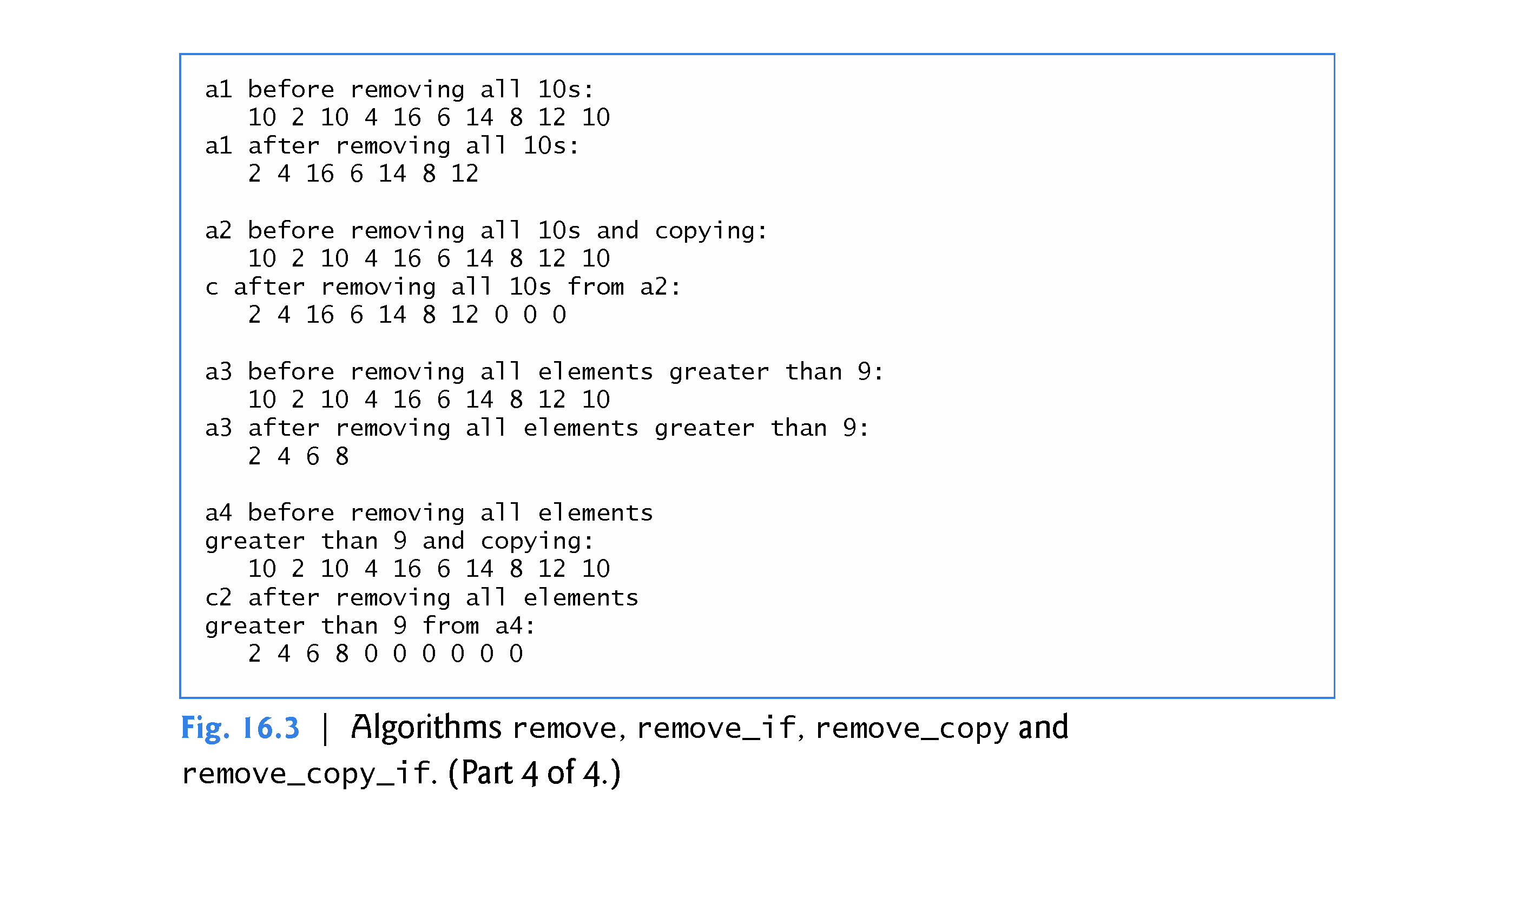

Slide 42
16.3.3 remove, remove_if, remove_copy and remove_copy_if (Cont.)
remove Algorithm
Line 22 uses the remove algorithm to eliminate from a1 all elements with the value 10 in the range from a1.begin() up to, but not including, a1.end().
The first two iterator arguments must be forward iterators.
This algorithm does not modify the number of elements in the container or destroy the eliminated elements, but it does move all elements that are not eliminated toward the beginning of the container.
The algorithm returns an iterator positioned after the last element that was not removed.
Elements from the iterator position to the end of the container have unspecified values.

Slide 43
16.3.3 remove, remove_if, remove_copy and remove_copy_if (Cont.)
remove_if Algorithm
Line 32 uses the remove_copy algorithm to copy all elements from a2 that do not have the value 10 in the range from a2.cbegin() up to, but not including, a2.cend().
The elements are placed in c, starting at position c.begin().
The iterators supplied as the first two arguments must be input iterators.
The iterator supplied as the third argument must be an output iterator so that the element being copied can be inserted into the copy location.
This algorithm returns an iterator positioned after the last element copied into vector c.

Slide 44
16.3.3 remove, remove_if, remove_copy and remove_copy_if (Cont.)
remove_if Algorithm
Line 41 uses the remove_if algorithm to delete from a3 all those elements in the range from a3.begin() up to, but not including, a3.end() for which our user-defined unary predicate function greater9 returns true.
Function greater9 (defined in lines 61–64) returns true if the value passed to it’s greater than 9; otherwise, it returns false.

Slide 45
16.3.3 remove, remove_if, remove_copy and remove_copy_if (Cont.)
The iterators supplied as the first two arguments must be forward iterators.
This algorithm does not modify the number of elements in the container, but it does move to the beginning of the container all elements that are not removed.
This algorithm returns an iterator positioned after the last element that was not removed.
All elements from the iterator position to the end of the container have undefined values.

Slide 46
16.3.3 remove, remove_if, remove_copy and remove_copy_if (Cont.)
remove_copy_if Algorithm
Line 53 uses the remove_copy_if algorithm to copy all those elements from a4 in the range from a4.cbegin() up to, but not including, a4.cend() for which the unary predicate function greater9 returns true.
The elements are placed in c2, starting at c2.begin().
The iterators supplied as the first two arguments must be input iterators.
The iterator supplied as the third argument must be an output iterator so that the element being copied can be assigned to the copy location.
This algorithm returns an iterator positioned after the last element copied into c2.

Slide 47
16.3.4 replace, replace_if, replace_copy and replace_copy_if
Figure 16.4 demonstrates replacing values from a sequence using algorithms replace, replace_if, replace_copy and replace_copy_if.

Slide 48
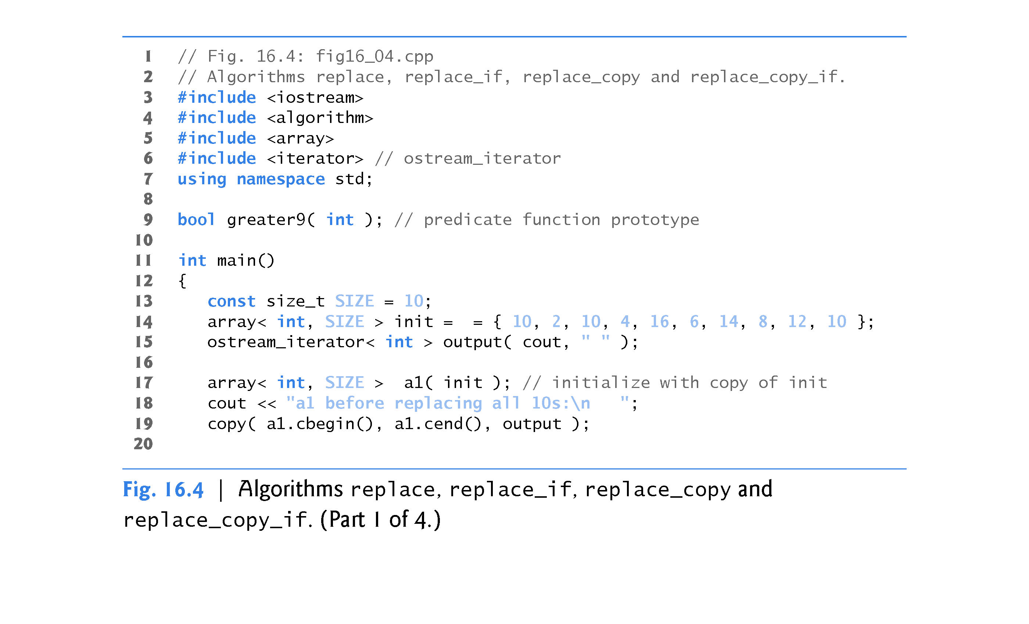

Slide 49
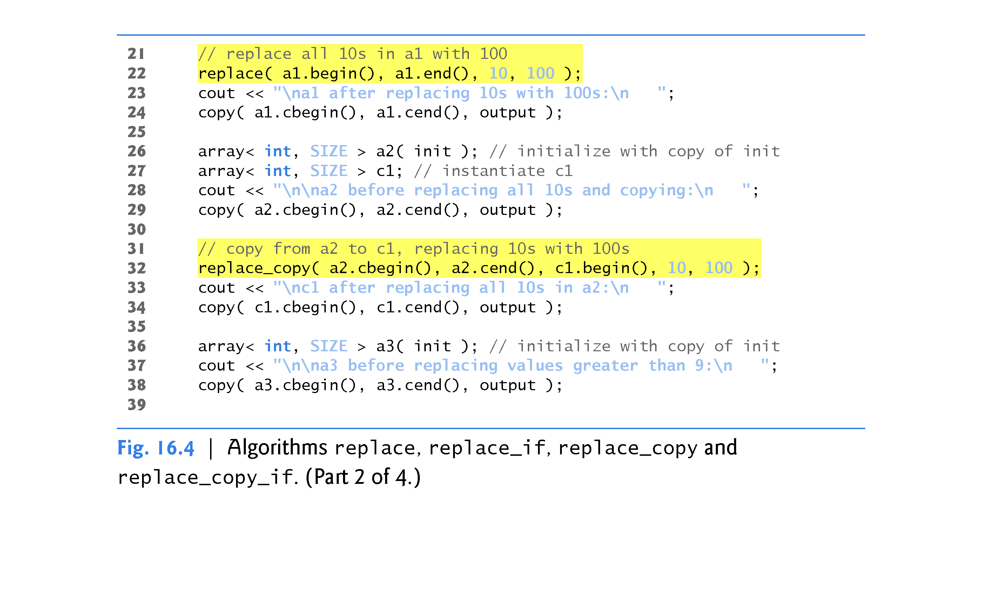

Slide 50
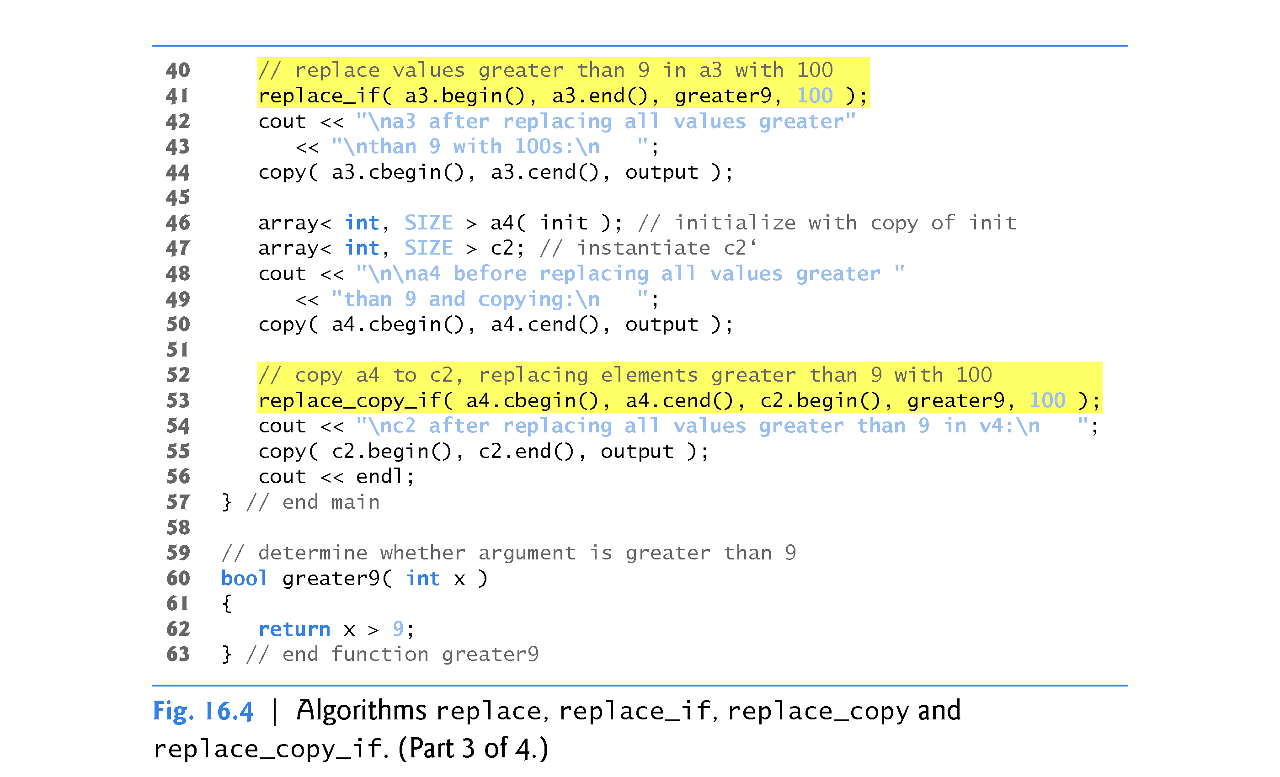

Slide 51
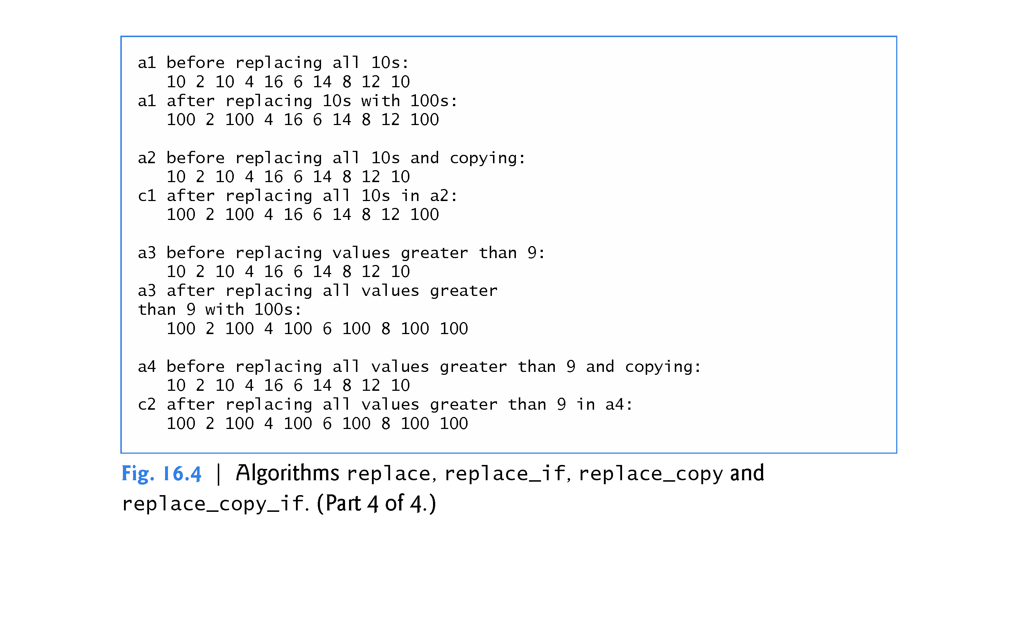

Slide 52
16.3.4 replace, replace_if, replace_copy and replace_copy_if (Cont.)
replace Algorithm
Line 22 uses the replace algorithm to replace all elements with the value 10 in the range a1.begin() up to, but not including, a1.end() with the new value 100.
The iterators supplied as the first two arguments must be forward iterators so that the algorithm can modify the elements in the sequence.

Slide 53
16.3.4 replace, replace_if, replace_copy and replace_copy_if (Cont.)
replace_copy Algorithm
Line 33 uses the replace_copy algorithm to copy all elements in the range a2.cbegin() up to, but not including, a2.cend(), replacing all elements with the value 10 with the new value 100.
The elements are copied into c1, starting at position c1.begin().
The iterators supplied as the first two arguments must be input iterators.
The iterator supplied as the third argument must be an output iterator so that the element being copied can be assigned to the copy location.
This function returns an iterator positioned after the last element copied into c1.

Slide 54
16.3.4 replace, replace_if, replace_copy and replace_copy_if (Cont.)
replace_if Algorithm
Line 41 uses the replace_if algorithm to replace all those elements from a3.begin() up to, but not including, a3.end() for which the unary predicate function greater9 returns true.
Function greater9 (defined in lines 60–63) returns true if the value passed to it is greater than 9; otherwise, it returns false.
The value 100 replaces each value greater than 9.
The iterators supplied as the first two arguments must be forward iterators.

Slide 55
16.3.4 replace, replace_if, replace_copy and replace_copy_if (Cont.)
replace_copy_if Algorithm
Line 53 uses the replace_copy_if algorithm to copy all elements from a4.cbegin() up to, but not including, a4.cend().
Elements for which the unary predicate function greater9 returns true are replaced with the value 100.
The elements are placed in c2, starting at position c2.begin().

Slide 56
16.3.4 replace, replace_if, replace_copy and replace_copy_if (Cont.)
The iterators supplied as the first two arguments must be input iterators.
The iterator supplied as the third argument must be an output iterator so that the element being copied can be assigned to the copy location.
This algorithm returns an iterator positioned after the last element copied into c2.

Slide 57
16.3.5 Mathematical Algorithms
Figure 16.5 demonstrates several common mathematical algorithms, including random_shuffle, count, count_if, min_element, max_element, accumulate, minmax_element, for_each and transform.

Slide 58
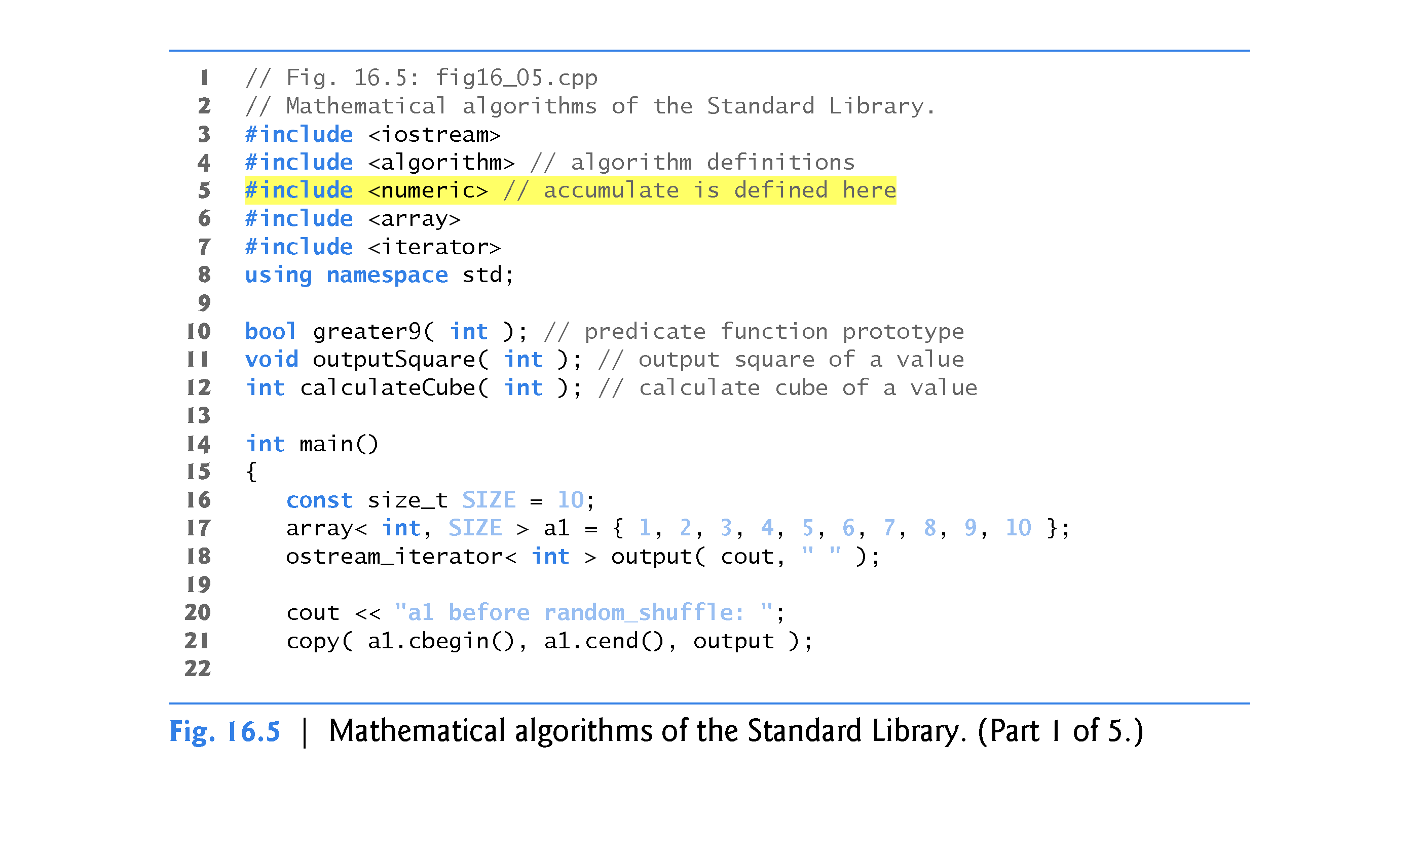

Slide 59
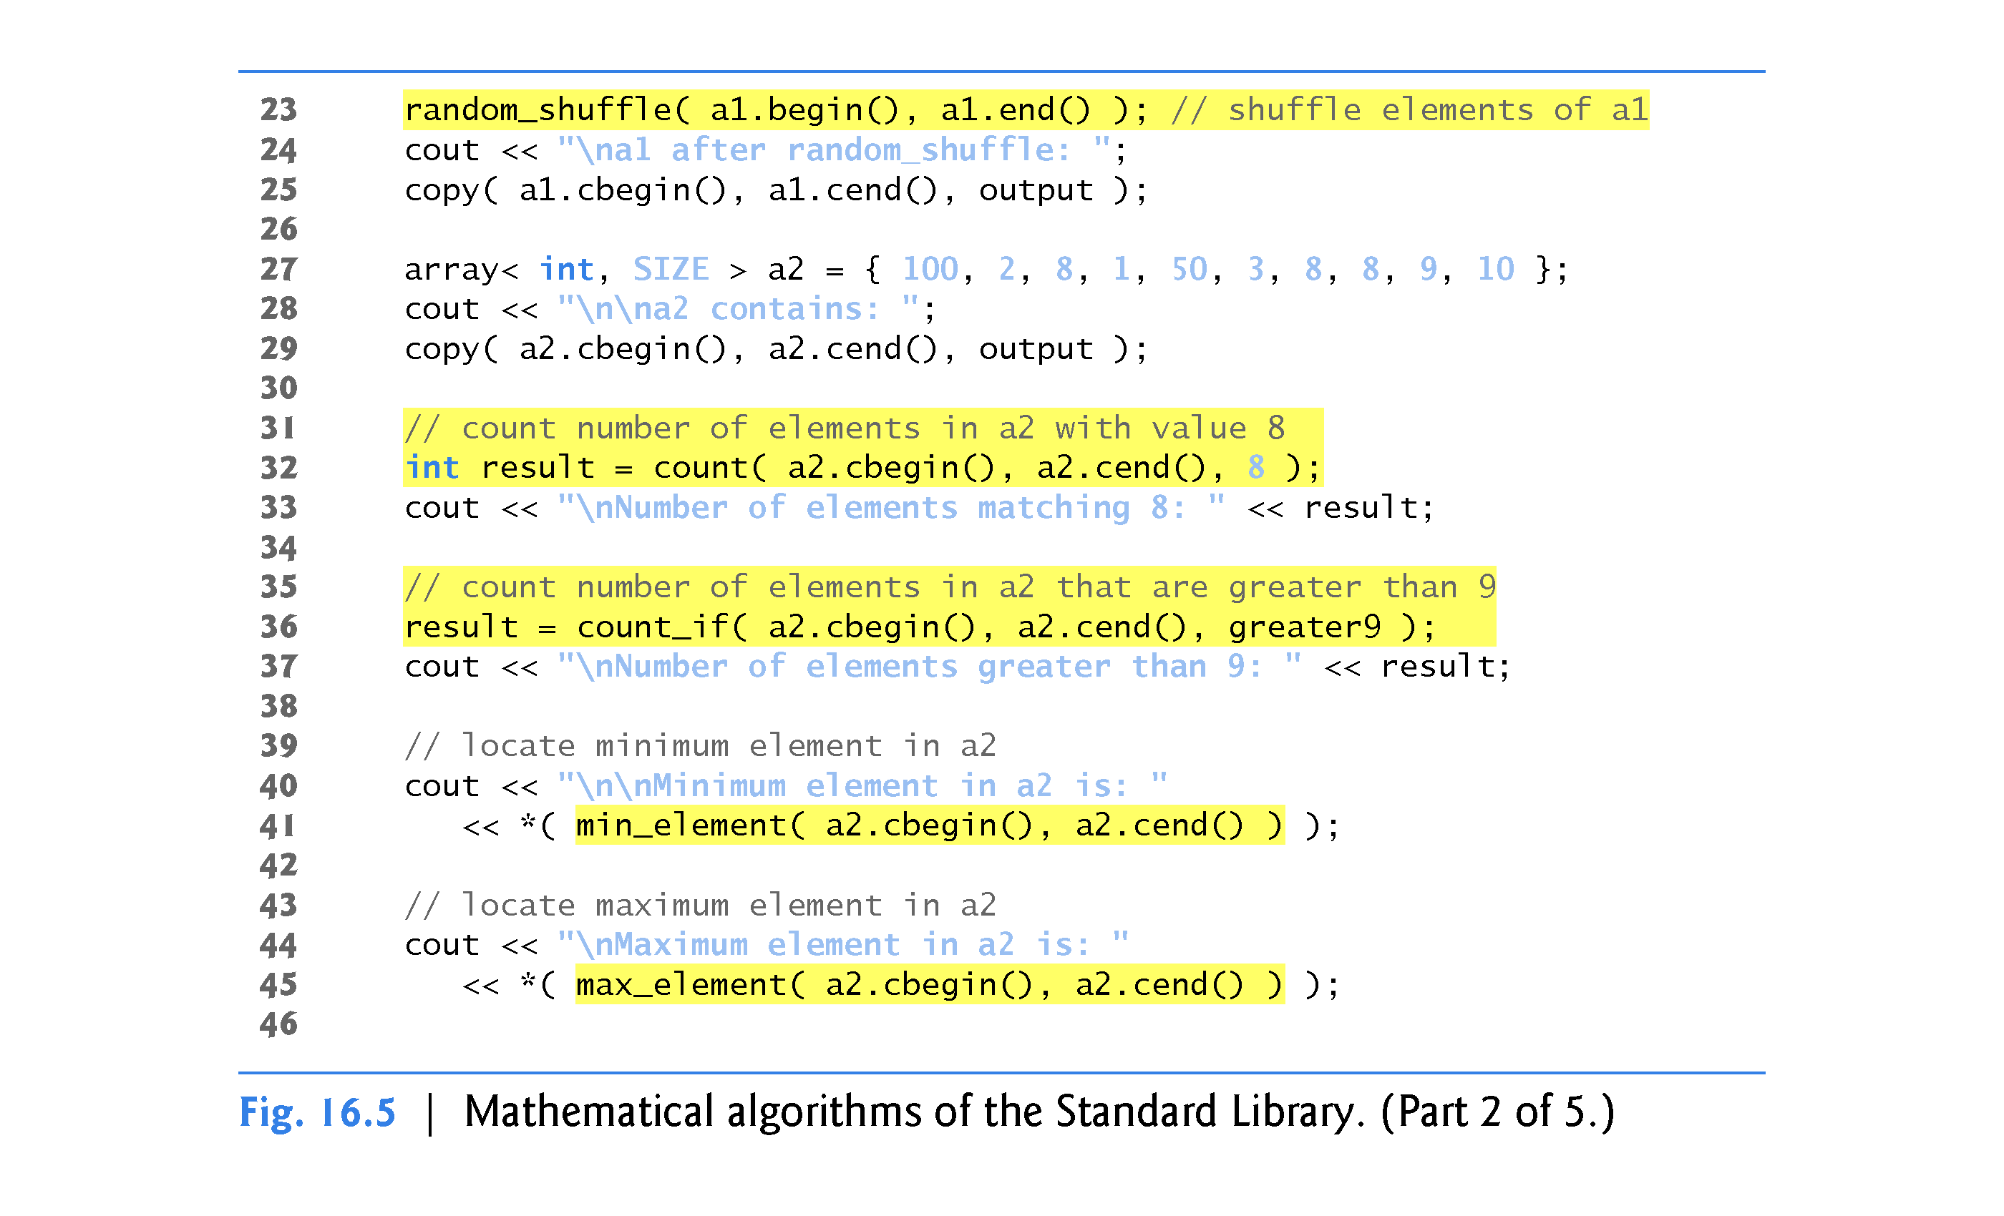

Slide 60
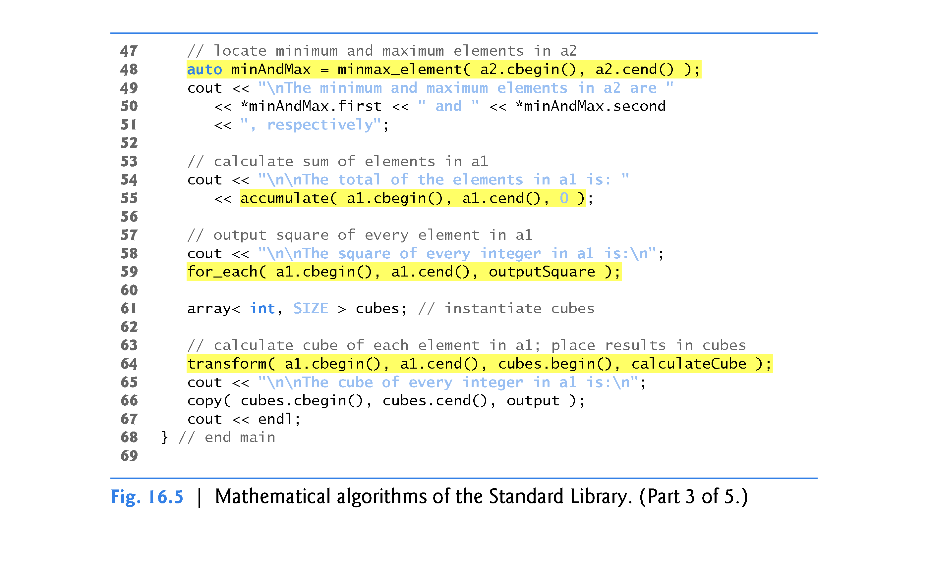

Slide 61
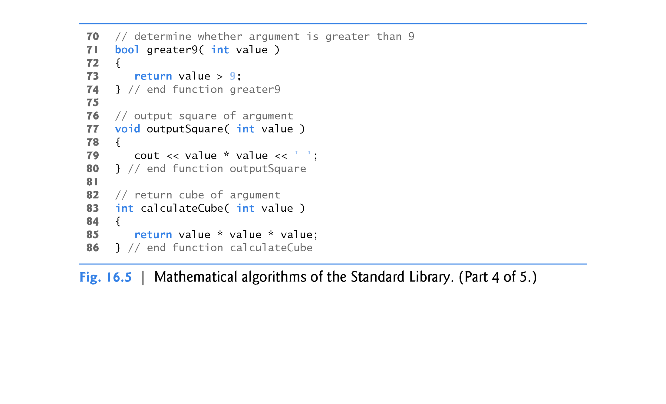

Slide 62
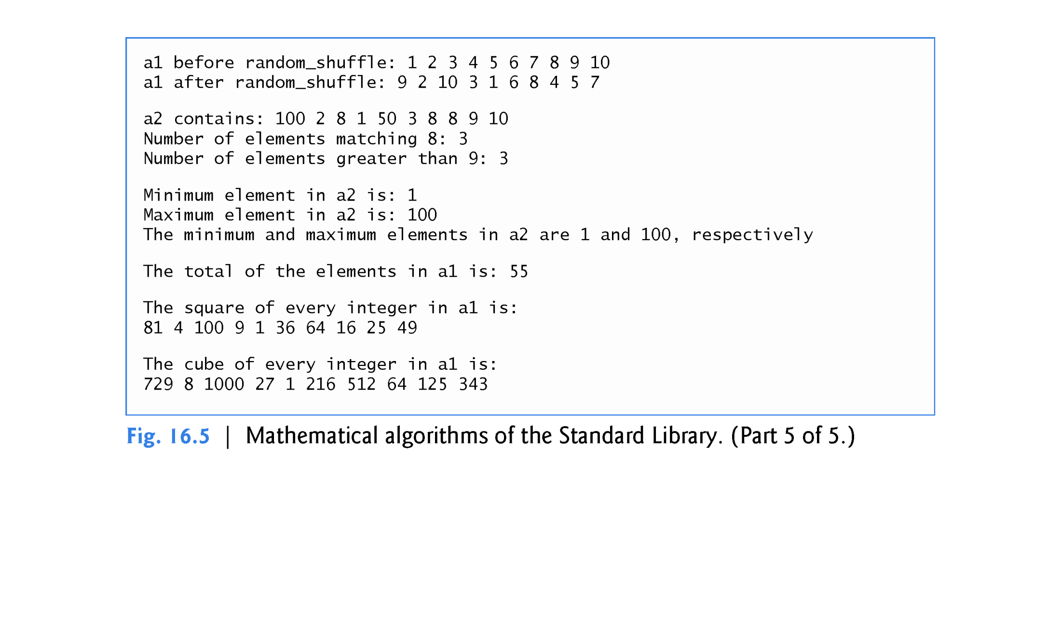

Slide 63
16.3.5 Mathematical Algorithms (Cont.)
random_shuffle Algorithm
Line 23 uses the random_shuffle algorithm to reorder randomly the elements in the range a1.begin() up to, but not including, a1.end().
This algorithm takes two random-access iterator arguments. This version of random_shuffle uses rand for randomization and produces the same results each time you run the program unless you seed the random-number generator with srand.
Another version of random_shuffle receives as its third argument a C++11 uniform random-number generator.

Slide 64
16.3.5 Mathematical Algorithms (Cont.)
count Algorithm
Line 32 uses the count algorithm to count the elements with the value 8 in the range a2.cbegin() up to, but not including, a2.cend().
This algorithm requires its two iterator arguments to be at least input iterators.

Slide 65
16.3.5 Mathematical Algorithms (Cont.)
count_if Algorithm
Line 36 uses the count_if algorithm to count elements in the range from a2.cbegin() up to, but not including, a2.cend() for which the predicate function greater9 returns true.
Algorithm count_if requires its two iterator arguments to be at least input iterators.

Slide 66
16.3.5 Mathematical Algorithms (Cont.)
Min_element Algorithm
Line 41 uses the min_element algorithm to locate the smallest element in the range from a2.cbegin() up to, but not including, a2.cend().
The algorithm returns a forward iterator located at the first smallest element, or a2.end() if the range is empty.
The algorithm’s two iterator arguments must be at least forward iterators.
A second version of this algorithm takes as its third argument a binary function that compares two elements in the sequence.
This algorithm returns the bool value true if the first argument is less than the second.

Slide 67
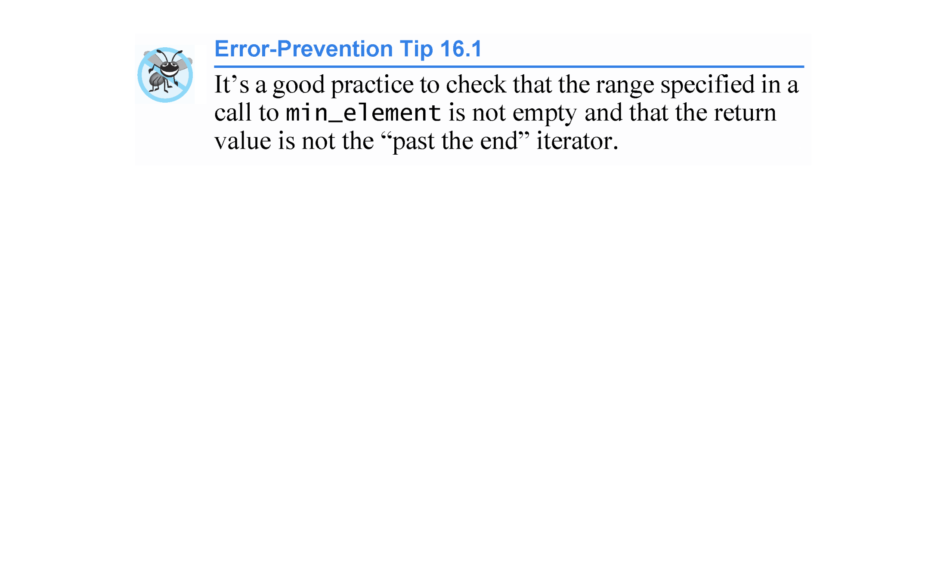

Slide 68
16.3.5 Mathematical Algorithms (Cont.)
max_element Algorithm
Line 45 uses the max_element algorithm to locate the largest element in the range from a2.cbegin() up to, but not including, a2.cend().
The algorithm returns a forward iterator located at the first largest element.
The algorithm’s two iterator arguments must be at least forward iterators.
A second version of this algorithm takes as its third argument a binary predicate function that compares the elements in the sequence.
The binary function takes two arguments and returns the bool value true if the first argument is less than the second.

Slide 69
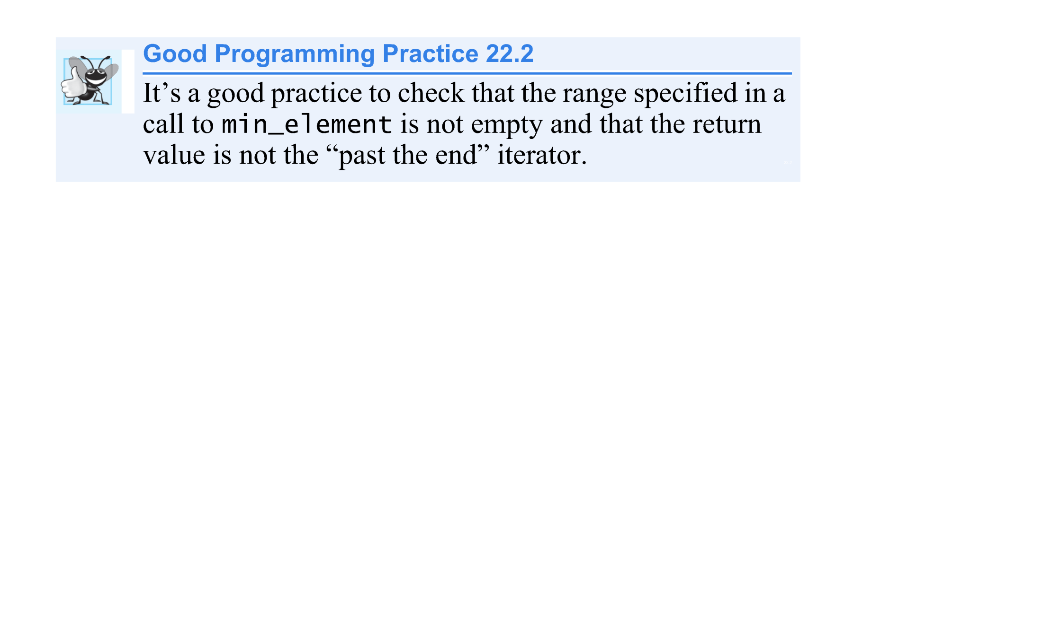

Slide 70
16.3.5 Mathematical Algorithms (Cont.)
C++11: minmax_element Algorithm
Line 48 uses the new minmax_element algorithm to locate both the smallest and largest elements in the range from a2.cbegin() up to, but not including, a2.cend().
The algorithm returns a pair of forward iterators located at the smallest and largest elements, respectively.
If there are duplicate smallest or largest elements, the iterators are located at the first smallest and last largest values. .
The algorithm’s two iterator arguments must be at least forward iterators.
A second version of this algorithm takes as its third argument a binary predicate function that compares the elements in the sequence.
The binary function takes two arguments and returns the bool value true if the first argument is less than the second.

Slide 71
16.3.5 Mathematical Algorithms (Cont.)
accumulate Algorithm
Line 55 uses the accumulate algorithm (the template of which is in header <numeric>) to sum the values in the range from a1.cbegin() up to, but not including, a1.cend().
The algorithm’s two iterator arguments must be at least input iterators and its third argument represents the initial value of the total.
A second version of this algorithm takes as its fourth argument a general function that determines how elements are accumulated.
The general function must take two arguments and return a result.

Slide 72
16.3.5 Mathematical Algorithms (Cont.)
The first argument to this function is the current value of the accumulation.
The second argument is the value of the current element in the sequence being accumulated.

Slide 73
16.3.5 Mathematical Algorithms (Cont.)
for_each Algorithm
Line 59 uses the for_each algorithm to apply a general function to every element in the range from a1.cbegin() up to, but not including, a1.cend().
The general function takes the current element as an argument and may modify that element (if it’s received by reference and is not const).
Algorithm for_each requires its two iterator arguments to be at least input iterators.

Slide 74
16.3.5 Mathematical Algorithms (Cont.)
transform Algorithm
Line 63 uses the transform algorithm to apply a general function to every element in the range from a1.cbegin() up to, but not including, a1.cend().
The general function (the fourth argument) should take the current element as an argument, must not modify the element and should return the transformed value.
Algorithm transform requires its first two iterator arguments to be at least input iterators and its third argument to be at least an output iterator.
The third argument specifies where the transformed values should be placed.
Note that the third argument can equal the first.

Slide 75
16.3.5 Mathematical Algorithms (Cont.)
Another version of transform accepts five arguments—the first two arguments are input iterators that specify a range of elements from one source container, the third argument is an input iterator that specifies the first element in another source container, the fourth argument is an output iterator that specifies where the transformed values should be placed and the last argument is a general function that takes two arguments.
This version of transform takes one element from each of the two input sources and applies the general function to that pair of elements, then places the transformed value at the location specified by the fourth argument.

Slide 76
16.3.6 Basic Searching and Sorting Algorithms
Figure 16.6 demonstrates some basic searching and sorting capabilities of the Standard Library, including find, find_if, sort, binary_search, all_of, any_of, none_of and find_if_not.

Slide 77
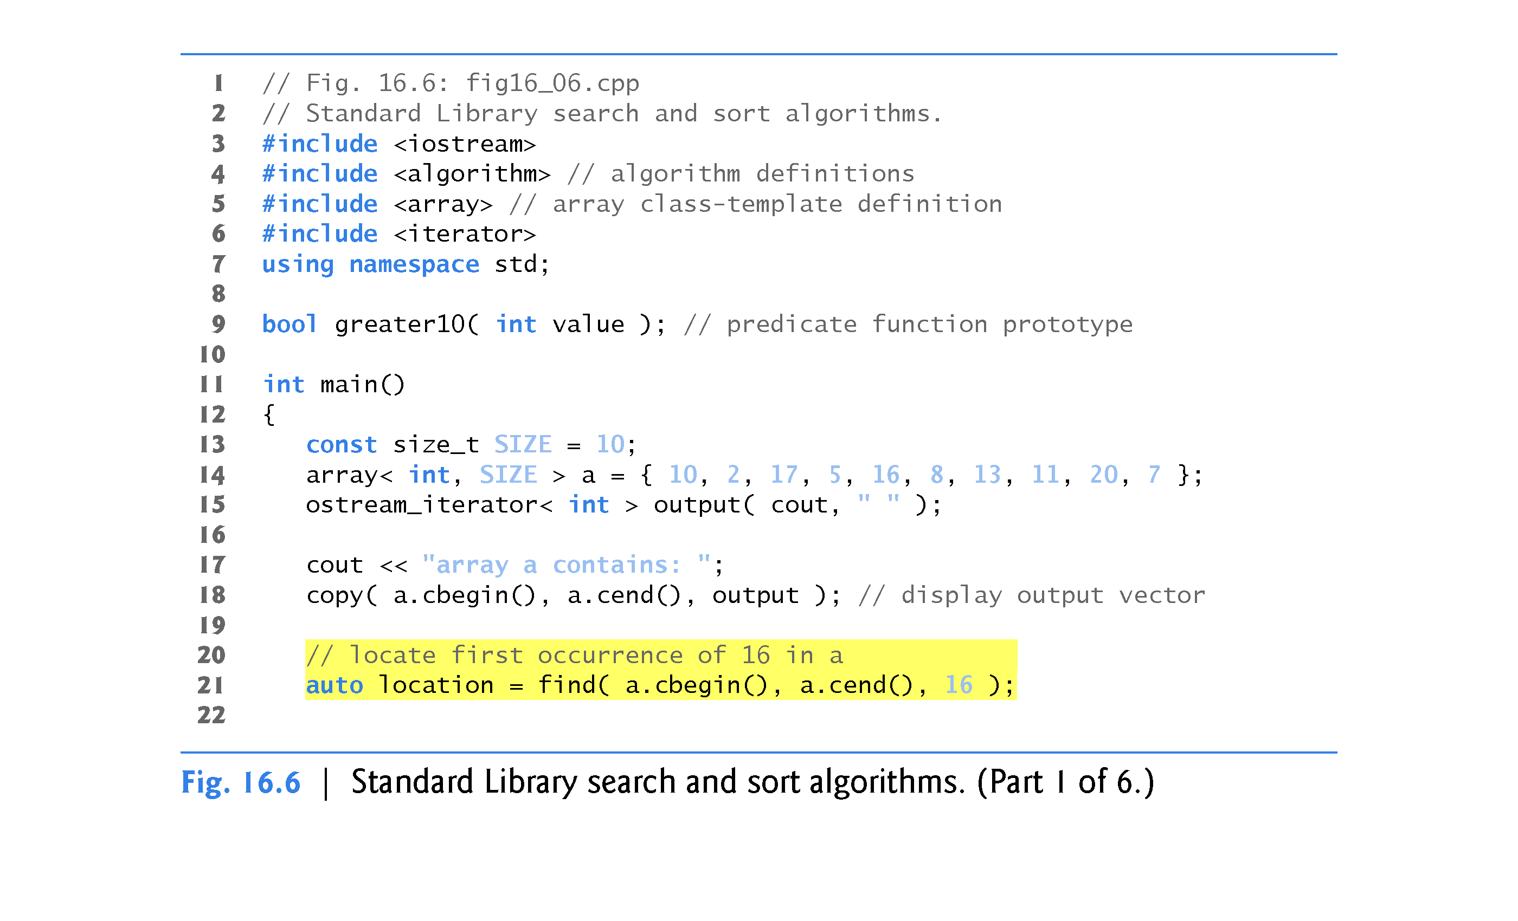

Slide 78
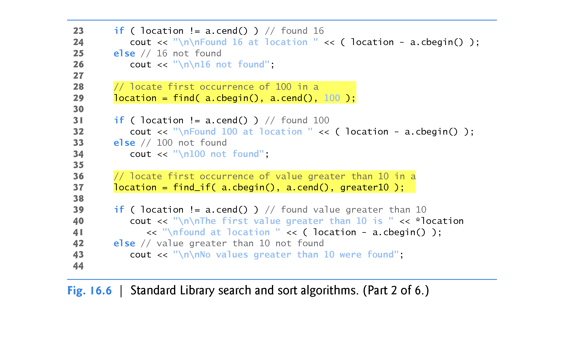

Slide 79
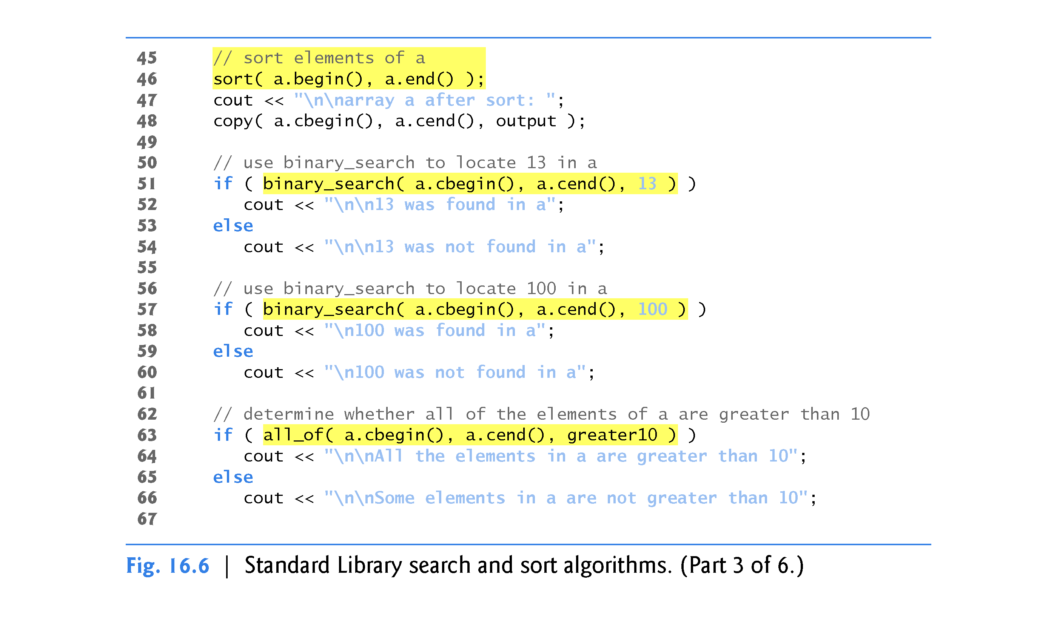

Slide 80
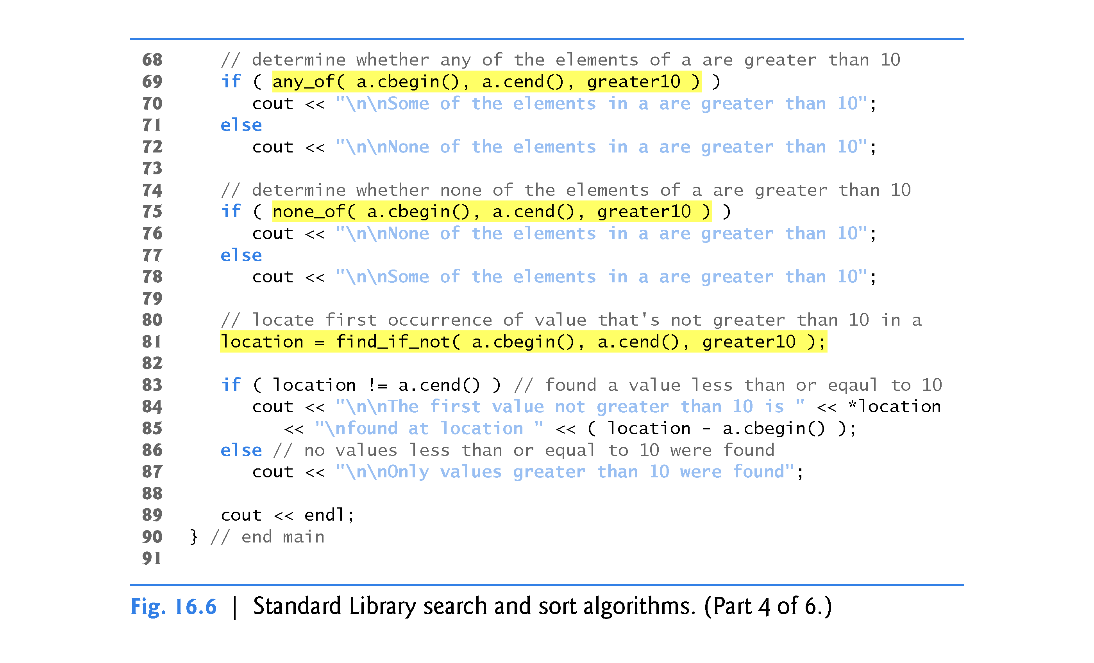

Slide 81
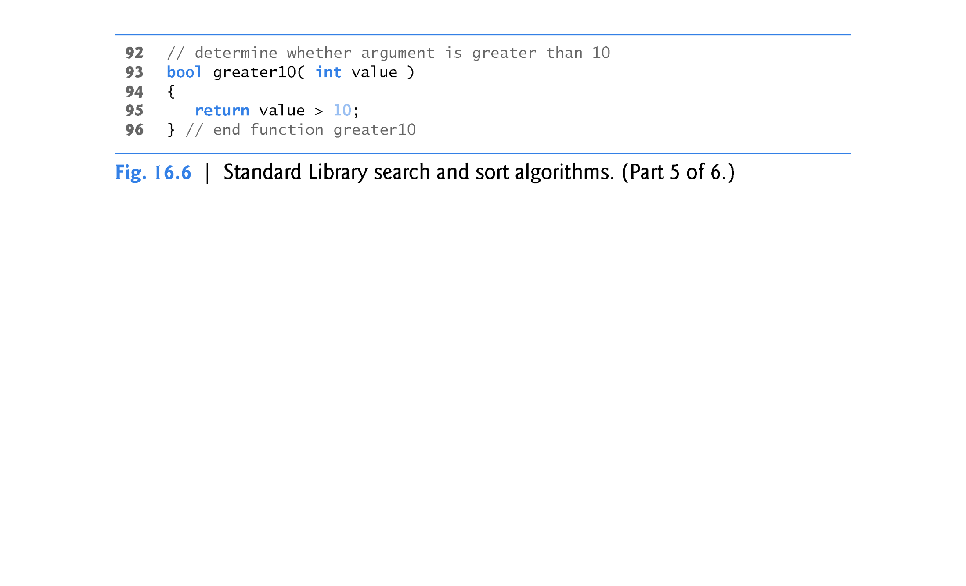

Slide 82
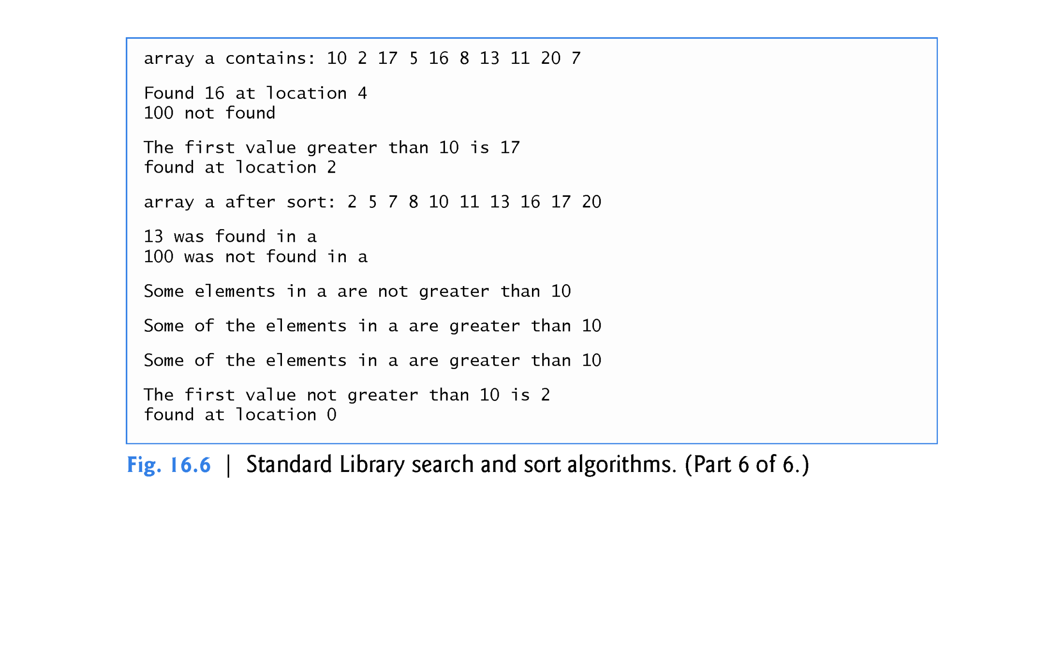

Slide 83
16.3.6 Basic Searching and Sorting Algorithms (Cont.)
find Algorithm
Line 21 uses the find algorithm to locate the value 16 in the range from a.cbegin() up to, but not including, a.cend().
The algorithm requires its two iterator arguments to be at least input iterators and returns an input iterator that either is positioned at the first element containing the value or indicates the end of the sequence (as is the case in line 29).

Slide 84
16.3.6 Basic Searching and Sorting Algorithms (Cont.)
find_if Algorithm
Line 37 uses the find_if algorithm (a linear search)to locate the first value in the range from a.cbegin() up to, but not including, a.cend() for which the unary predicate function greater10 returns true.
Function greater10 (defined in lines 93–96) takes an integer and returns a bool value indicating whether the integer argument is greater than 10.
Algorithm find_if requires its two iterator arguments to be at least input iterators.
The algorithm returns an input iterator that either is positioned at the first element containing a value for which the predicate function returns true or indicates the end of the sequence.

Slide 85
16.3.6 Basic Searching and Sorting Algorithms (Cont.)
sort Algorithm
Line 46 uses the sort algorithm to arrange the elements in the range from a.begin() up to, but not including, a.end() in ascending order.
The algorithm requires its two iterator arguments to be random-access iterators.
A second version of this algorithm takes a third argument that is a binary predicate function taking two arguments that are values in the sequence and returning a bool indicating the sorting order—if the return value is true, the two elements being compared are in sorted order.

Slide 86
16.3.6 Basic Searching and Sorting Algorithms (Cont.)
binary_search Algorithm
Line 53 uses the binary_search algorithm to determine whether the value 13 is in the range from a.cbegin() up to, but not including, a.cend().
The values must be sorted in ascending order.
Algorithm binary_search requires its two iterator arguments to be at least forward iterators.
The algorithm returns a bool indicating whether the value was found in the sequence.

Slide 87
16.3.6 Basic Searching and Sorting Algorithms (Cont.)
Line 57 demonstrates a call to binary_search in which the value is not found.
A second version of this algorithm takes a fourth argument that is a binary predicate function taking two arguments that are values in the sequence and returning a bool.
The predicate function returns true if the two elements being compared are in sorted order.
To obtain the location of the search key in the container, use the lower_bound or find algorithms.

Slide 88
16.3.6 Basic Searching and Sorting Algorithms (Cont.)
C++11: all_of Algorithm
Line 63 uses the all_of algorithm to determine whether the unary predicate function greater10 returns true for all of the elements in the range from a.cbegin() up to, but not including, a.cend().
Algorithm all_of requires its two iterator arguments to be at least input iterators.

Slide 89
16.3.6 Basic Searching and Sorting Algorithms (Cont.)
C++11: any_of Algorithm
Line 69 uses the any_of algorithm to determine whether the unary predicate function greater10 returns true for at least one of the elements in the range from a.cbegin() up to, but not including, a.cend().
Algorithm any_of requires its two iterator arguments to be at least input iterators.

Slide 90
16.3.6 Basic Searching and Sorting Algorithms (Cont.)
C++11: none_of Algorithm
Line 75 uses the none_of algorithm to determine whether the unary predicate function greater10 returns false for all of the elements in the range from a.cbegin() up to, but not including, a.cend().
Algorithm none_of requires its two iterator arguments to be at least input iterators.

Slide 91
16.3.6 Basic Searching and Sorting Algorithms (Cont.)
C++11: find_if_not Algorithm
Line 81 uses the find_if_not algorithm to locate the first value in the range from a.cbegin() up to, but not including, a.cend() for which the unary predicate function greater10 returns false.
Algorithm find_if requires its two iterator arguments to be at least input iterators.
The algorithm returns an input iterator that either is positioned at the first element containing a value for which the predicate function returns false or indicates the end of the sequence.

Slide 92
16.3.7 swap, iter_swap and swap_ranges
Figure 16.7 demonstrates algorithms swap, iter_swap and swap_ranges for swapping elements.
swap Algorithm
Line 18 uses the swap algorithm to exchange two values.
In this example, the first and second elements of array a are exchanged.
The function takes as arguments references to the two values being exchanged.

Slide 93
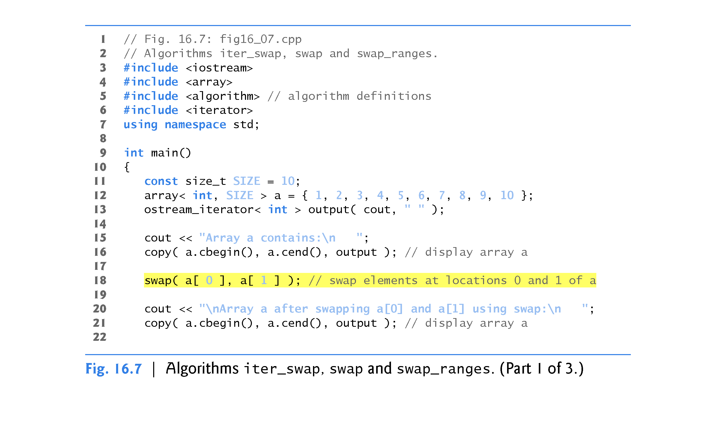

Slide 94
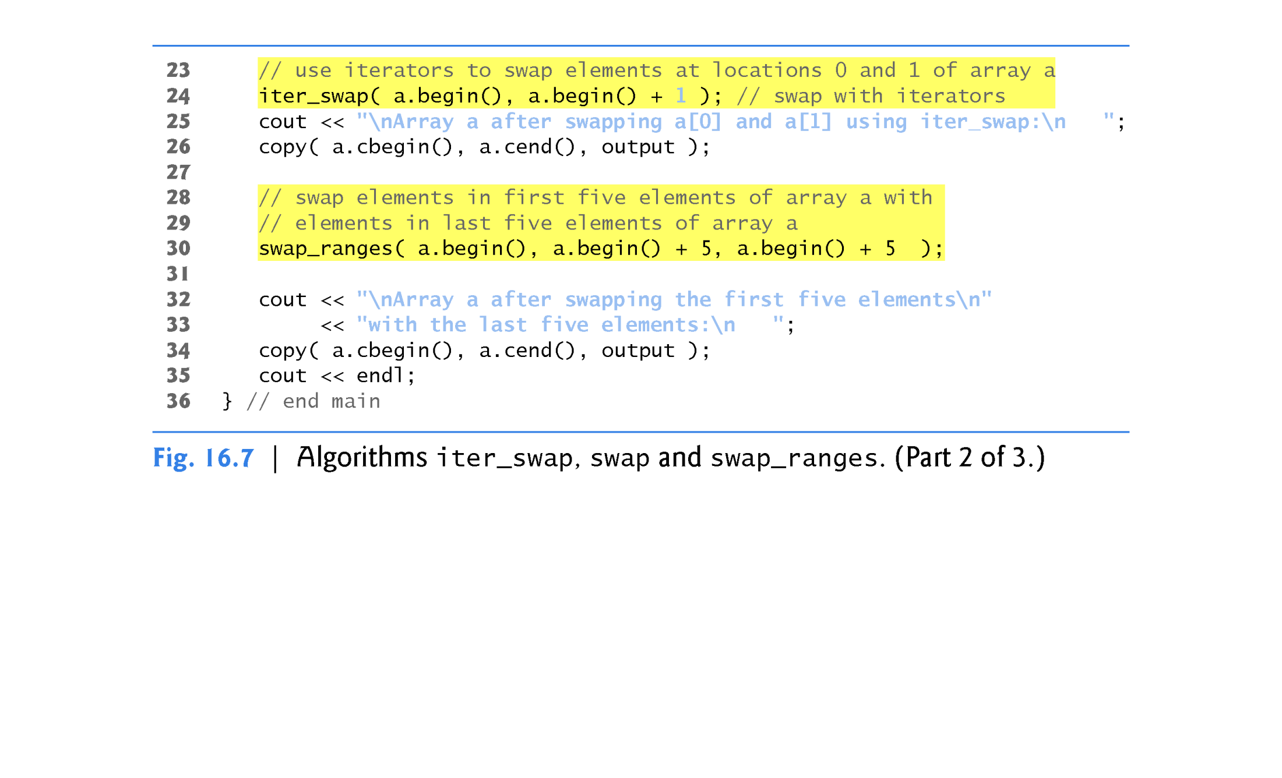

Slide 95
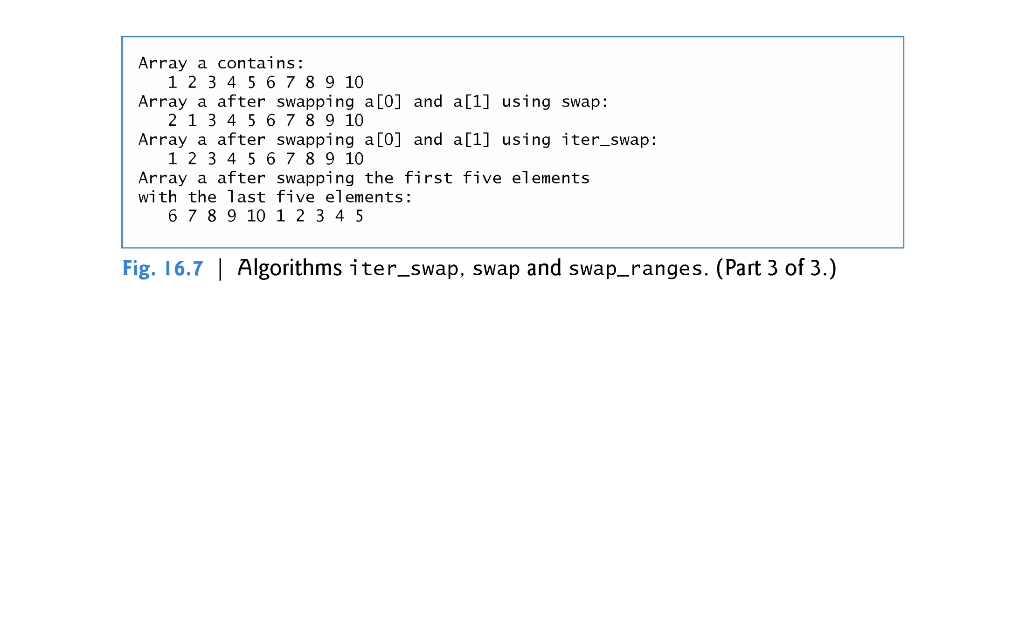

Slide 96
16.3.7 swap, iter_swap and swap_ranges (Cont.)
iter_swap Algorithm
Line 24 uses iter_swap to exchange the two elements.
The function takes two forward iterator arguments (in this case, iterators to elements of an array) and exchanges the values in the elements to which the iterators refer.
Line 30 uses swap_ranges to exchange the elements from a.begin() up to, but not including, a.begin() + 5 with the elements beginning at position a.begin() + 5.

Slide 97
16.3.7 swap, iter_swap and swap_ranges (Cont.)
The function requires three forward iterator arguments.
The first two arguments specify the range of elements in the first sequence that will be exchanged with the elements in the second sequence starting from the iterator in the third argument.
In this example, the two sequences of values are in the same array, but the sequences can be from different arrays or containers.
The sequences must not overlap.
The destination sequence must be large enough to contain all the elements of the ranges being swapped.

Slide 98
16.3.8 copy_backward, merge, unique and reverse
Figure 16.8 demonstrates algorithms copy_backward, merge, unique and reverse.

Slide 99
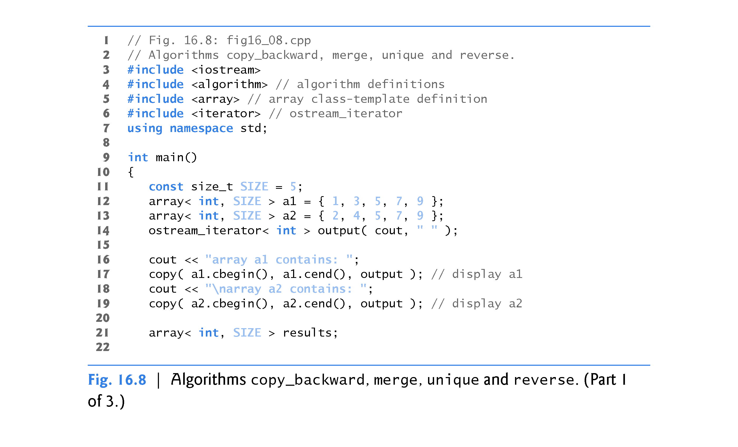

Slide 100
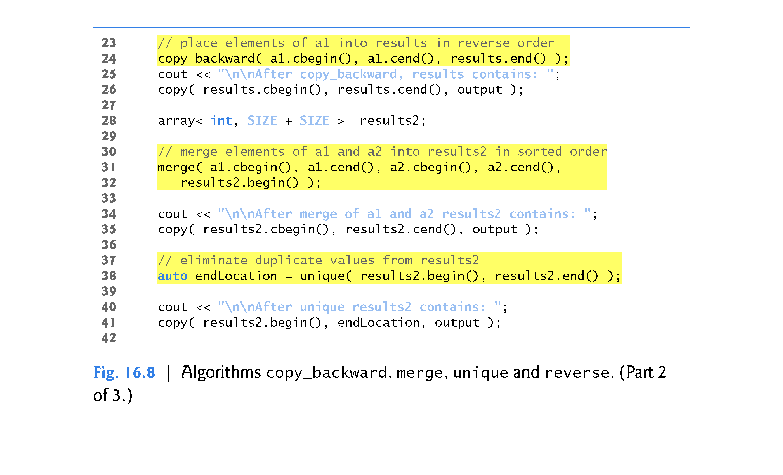

Slide 101
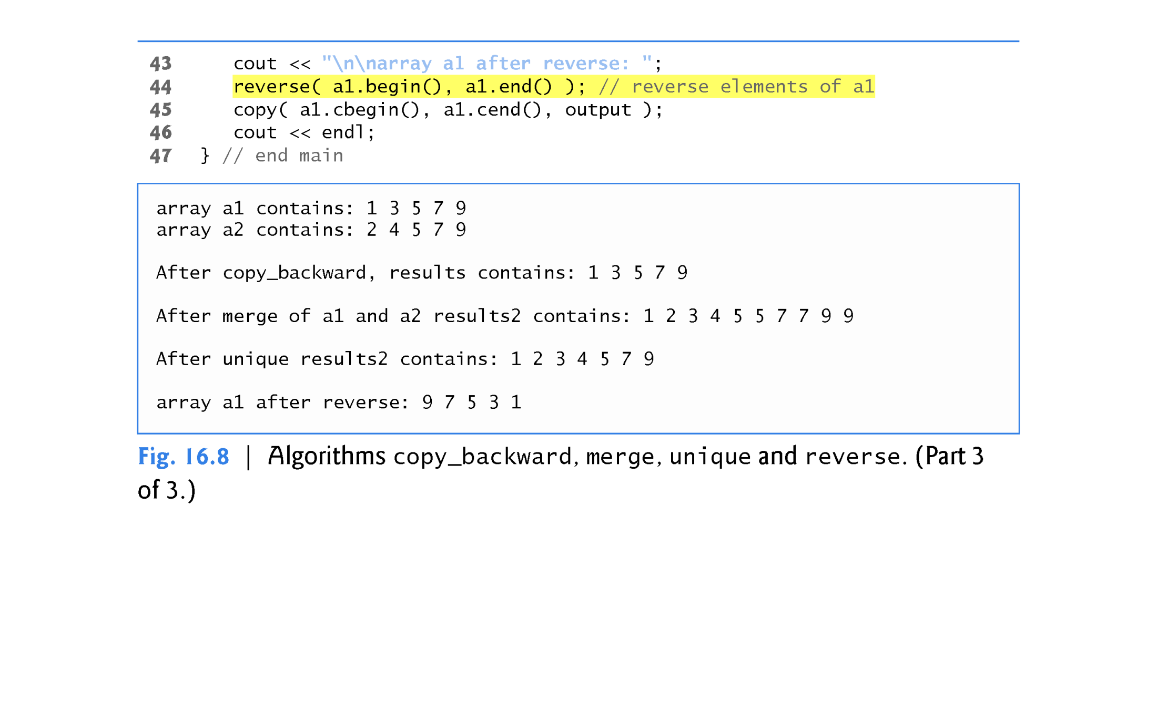

Slide 102
16.3.8 copy_backward, merge, unique and reverse
copy_backward Algorithm
Line 24 uses the copy_backward algorithm to copy elements in the range from a1.cbegin() up to, but not including, a1.cend(), placing the elements in results by starting from the element before results.end() and working toward the beginning of the array.
The algorithm returns an iterator positioned at the last element copied into the results (i.e., the beginning of results, because of the backward copy).
The elements are placed in results in the same order as a1.

Slide 103
16.3.8 copy_backward, merge, unique and reverse (Cont.)
This algorithm requires three bidirectional iterator arguments (iterators that can be incremented and decremented to iterate forward and backward through a sequence, respectively).
One difference between copy_backward and copy is that the iterator returned from copy is positioned after the last element copied and the one returned from copy_backward is positioned at the last element copied (i.e., the first element in the sequence).
Also, copy_backward can manipulate overlapping ranges of elements in a container as long as the first element to copy is not in the destination range of elements.

Slide 104
16.3.8 copy_backward, merge, unique and reverse (Cont.)
In addition to the copy and copy_backward algorithms, C++11 now includes the move and move_backward algorithms.
These use C++11’s new move semantics (discussed in Chapter 24, C++11: Additional Features) to move, rather than copy, objects from one container to another.

Slide 105
16.3.8 copy_backward, merge, unique and reverse (Cont.)
merge Algorithm
Lines 31-32 use the merge algorithm to combine two sorted ascending sequences of values into a third sorted ascending sequence.
The algorithm requires five iterator arguments.
The first four must be at least input iterators and the last must be at least an output iterator.
The first two arguments specify the range of elements in the first sorted sequence (a1), the second two arguments specify the range of elements in the second sorted sequence (a2) and the last argument specifies the starting location in the third sequence (results2) where the elements will be merged.
A second version of this algorithm takes as its sixth argument a binary predicate function that specifies the sorting order.

Slide 106
16.3.8 copy_backward, merge, unique and reverse (Cont.)
back_inserter, front_inserter and inserter Iterator Adapters
Line 28 creates the array results2 with the number of elements in a1 and a2.
Using the merge algorithm requires that the sequence where the results are stored be at least the size of the sequences being merged.
If you do not want to allocate the number of elements for the resulting sequence before the merge operation, you can use the following statements:
vector< int > results2; merge( a1.begin(), a1.end(), a2.begin(), a2.end(), back_inserter( results2 ) );

Slide 107
16.3.8 copy_backward, merge, unique and reverse (Cont.)
The argument back_inserter(results2) uses function template back_in-serter (header <iterator>) for the vector results2.
A back_in-serter calls the container’s default push_back function to insert an element at the end of the container.
If an element is inserted into a container that has no more space available, the container grows in size—which is why we used a vector in the preceding statements, because arrays are fixed size.
Thus, the number of elements in the container does not have to be known in advance.

Slide 108
16.3.8 copy_backward, merge, unique and reverse (Cont.)
There are two other inserters—front_inserter (uses push_front to insert an element at the beginning of a container specified as its argument) and inserter (uses insert to insert an element at the iterator supplied as its second argument in the container supplied as its first argument).

Slide 109
16.3.8 copy_backward, merge, unique and reverse (Cont.)
unique Algorithm
Line 38 uses the unique algorithm on the sorted sequence of elements in the range from results2.begin() up to, but not including, results2.end().
After this algorithm is applied to a sorted sequence with duplicate values, only a single copy of each value remains in the sequence.
The algorithm takes two arguments that must be at least forward iterators.

Slide 110
16.3.8 copy_backward, merge, unique and reverse (Cont.)
The algorithm returns an iterator positioned after the last element in the sequence of unique values.
The values of all elements in the container after the last unique value are undefined.
A second version of this algorithm takes as a third argument a binary predicate function specifying how to compare two elements for equality.

Slide 111
16.3.8 copy_backward, merge, unique and reverse (Cont.)
reverse Algorithm
Line 44 uses the reverse algorithm to reverse all the elements in the range from a1.begin() up to, but not including, a1.end().
The algorithm takes two arguments that must be at least bidirectional iterators.

Slide 112
16.3.8 copy_backward, merge, unique and reverse (Cont.)
C++11: copy_if and copy_n Algorithms
The copy_if algorithm copies each element from a range if the unary predicate function in its fourth argument returns true for that element.
The iterators supplied as the first two arguments must be input iterators.
The iterator supplied as the third argument must be an output iterator so that the element being copied can be assigned to the copy location.
This algorithm returns an iterator positioned after the last element copied.
The copy_n algorithm copies the number of elements specified by its second argument from the location specified by its first argument (an input iterator).
The elements are output to the location specified by its third argument (an output iterator).

Slide 113
16.3.9 inplace_merge, unique_copy and reverse_copy
Figure 16.9 demonstrates algorithms inplace_merge, unique_copy and reverse_copy.

Slide 114
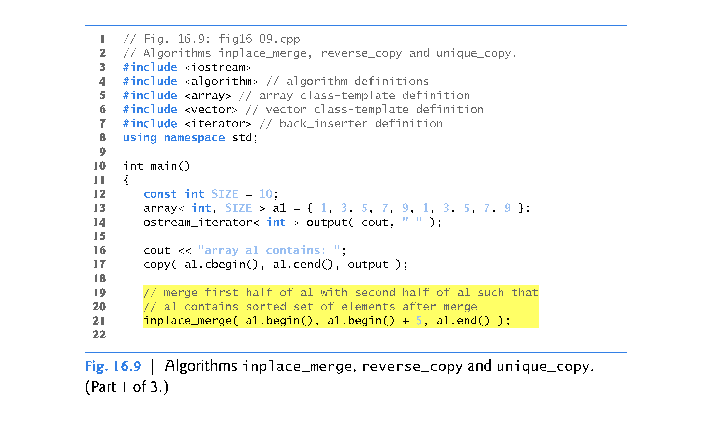

Slide 115
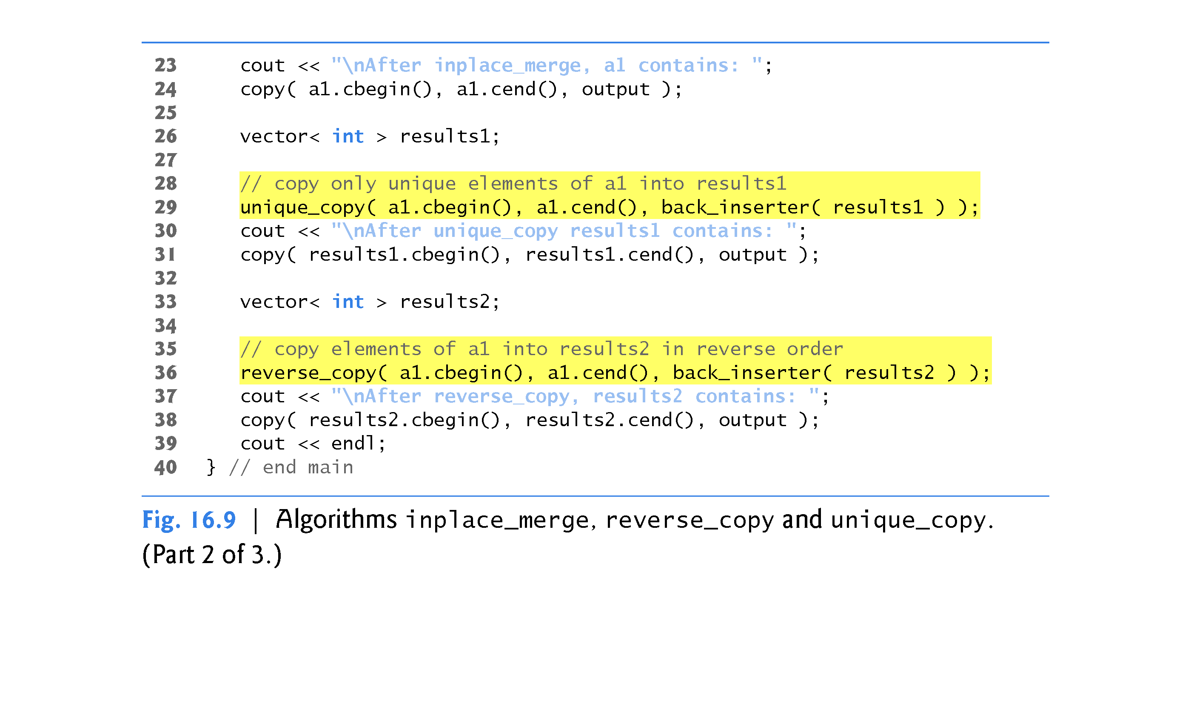

Slide 116
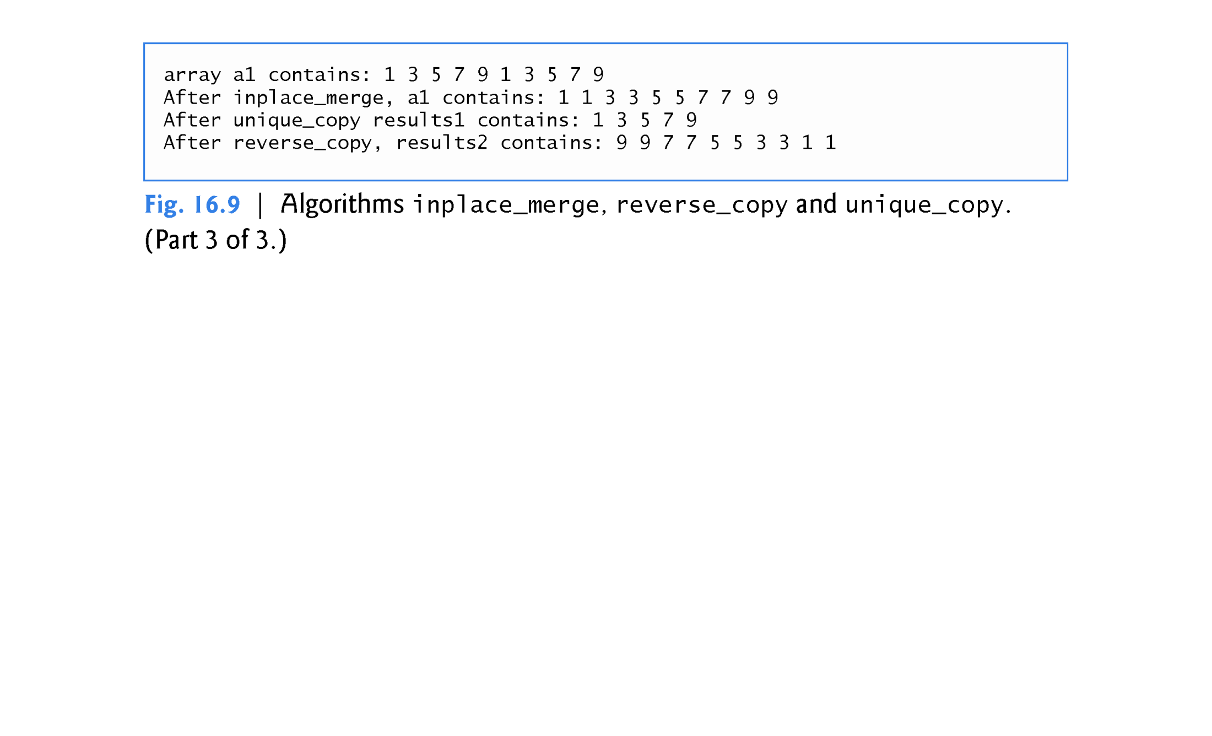

Slide 117
16.3.9 inplace_merge, unique_copy and reverse_copy (Cont.)
inplace_merge Algorithm
Line 21 uses the inplace_merge algorithm to merge two sorted sequences of elements in the same container.
In this example, the elements from a1.begin() up to, but not including, a1.begin() + 5 are merged with the elements from a1.begin() + 5 up to, but not including, a1.end().
This algorithm requires its three iterator arguments to be at least bidirectional iterators.
A second version of this algorithm takes as a fourth argument a binary predicate function for comparing elements in the two sequences.

Slide 118
16.3.9 inplace_merge, unique_copy and reverse_copy (Cont.)
unique_copy Algorithm
Line 29 uses the unique_copy algorithm to make a copy of all the unique elements in the sorted sequence of values from a1.cbegin() up to, but not including, a1.cend().
The copied elements are placed into vector results1.
The first two arguments must be at least input iterators and the last must be at least an output iterator.
In this example, we did not preallocate enough elements in results1 to store all the elements copied from a1.
Instead, we use function back_inserter (defined in header <iterator>) to add elements to the end of results1.

Slide 119
16.3.9 inplace_merge, unique_copy and reverse_copy (Cont.)
The back_inserter uses vector’s push_back member function to insert elements at the end of the vector.
Because the back_inserter inserts an element rather than replacing an existing element’s value, the vector is able to grow to accommodate additional elements.
A second version of the unique_copy algorithm takes as a fourth argument a binary predicate function for comparing elements for equality.

Slide 120
16.3.9 inplace_merge, unique_copy and reverse_copy (Cont.)
reverse_copy Algorithm
Line 36 uses the reverse_copy algorithm to make a reversed copy of the elements in the range from a1.cbegin() up to, but not including, a1.cend().
The copied elements are inserted into results2 using a back_inserter object to ensure that the vector can grow to accommodate the appropriate number of elements copied.
Algorithm reverse_copy requires its first two iterator arguments to be at least bidirectional iterators and its third to be at least an output iterator.

Slide 121
16.3.10 Set Operations
Figure 16.10 demonstrates algorithms includes, set_difference, set_intersection, set_symmetric_difference and set_union for manipulating sets of sorted values.

Slide 122
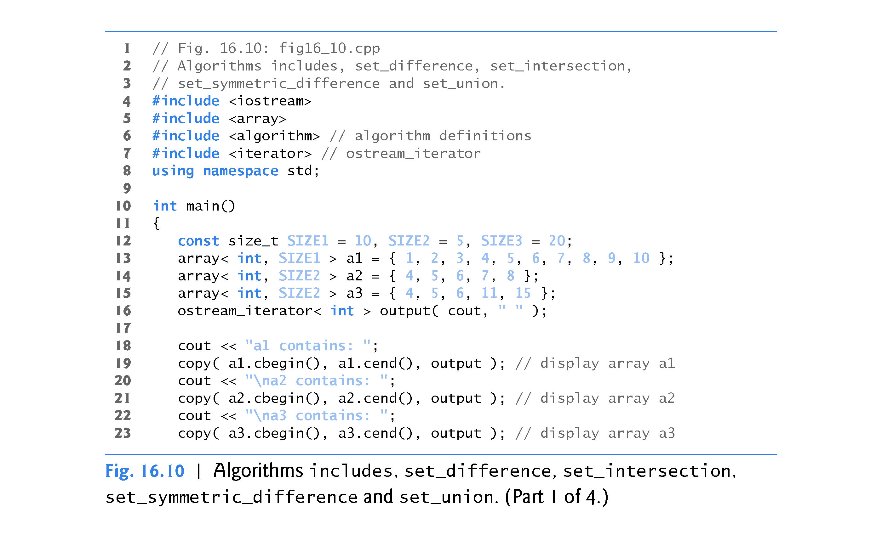

Slide 123
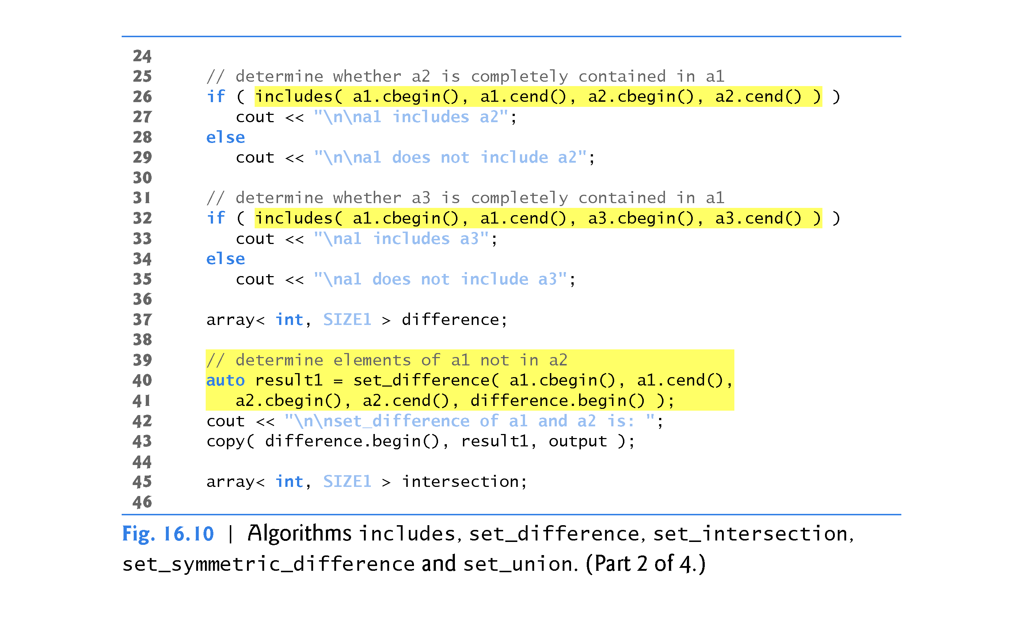

Slide 124
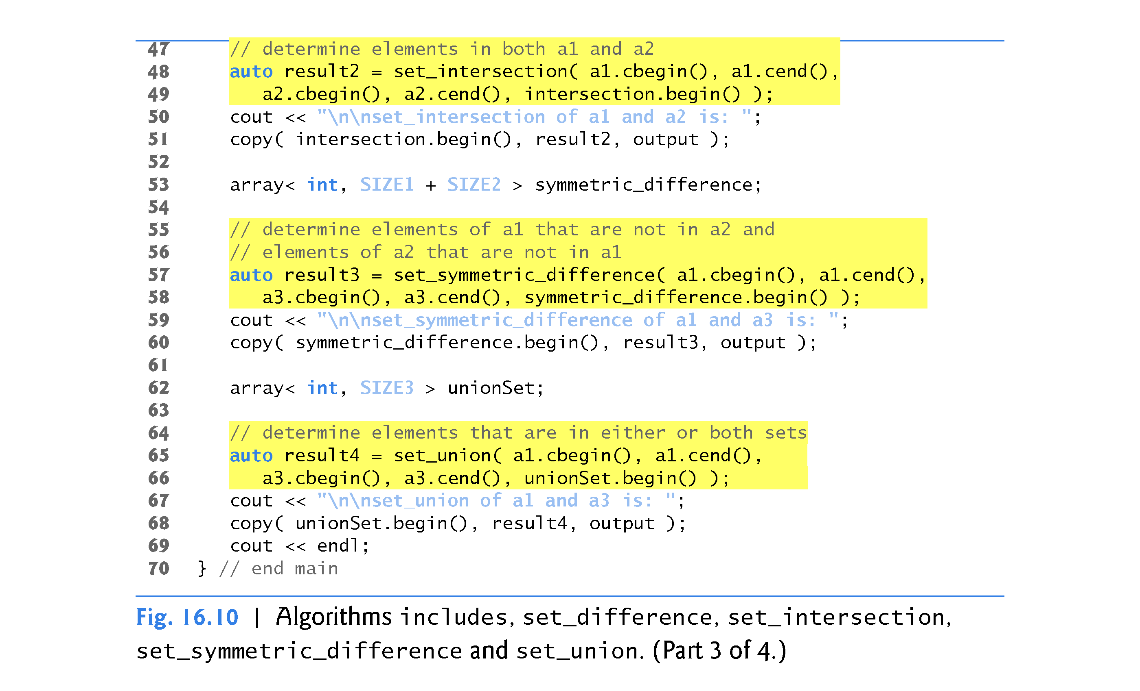

Slide 125
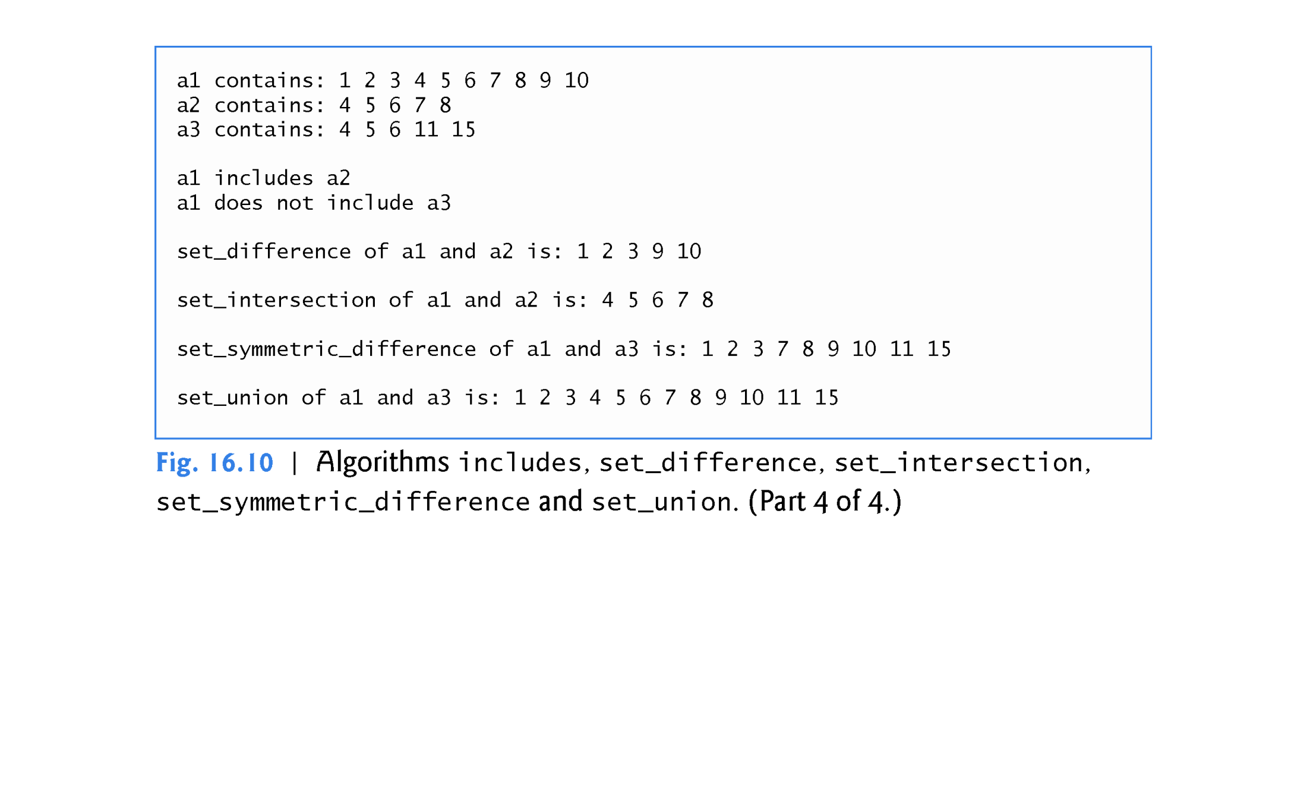

Slide 126
16.3.10 Set Operations
includes Algorithm
Lines 26 and 32 call the includes algorithm which compares two sets of sorted values to determine whether every element of the second set is in the first set.
If so, includes returns true; otherwise, it returns false.
The first two iterator arguments must be at least input iterators and must describe the first set of values.
In line 26, the first set consists of the elements from a1.cbegin() up to, but not including, a1.cend().

Slide 127
16.3.10 Set Operations (Cont.)
The last two iterator arguments must be at least input iterators and must describe the second set of values.
In this example, the second set consists of the elements from a2.cbegin() up to, but not including, a2.cend().
A second version of algorithm includes takes a fifth argument that is a binary predicate function indicating the order in which the elements were originally sorted.
The two sequences must be sorted using the same comparison function.

Slide 128
16.3.10 Set Operations (Cont.)
set_difference Algorithm
Lines 40–41 use the set_difference algorithm to find the elements from the first set of sorted values that are not in the second set of sorted values (both sets of values must be in ascending order).
The elements that are different are copied into the fifth argument (in this case, the array difference).
The first two iterator arguments must be at least input iterators for the first set of values.
The next two iterator arguments must be at least input iterators for the second set of values.
The fifth argument must be at least an output iterator indicating where to store a copy of the values that are different.

Slide 129
16.3.10 Set Operations (Cont.)
The algorithm returns an output iterator positioned immediately after the last value copied into the set to which the fifth argument points.
A second version of set_difference takes a sixth argument that is a binary predicate function indicating the order in which the elements were originally sorted.
The two sequences must be sorted using the same comparison function.

Slide 130
16.3.10 Set Operations (Cont.)
set_intersection Algorithm
Lines 48–49 use the set_intersection algorithm to determine the elements from the first set of sorted values that are in the second set of sorted values (both sets of values must be in ascending order).
The elements common to both sets are copied into the fifth argument (in this case, array intersection).
The first two iterator arguments must be at least input iterators for the first set of values.

Slide 131
16.3.10 Set Operations (Cont.)
The next two iterator arguments must be at least input iterators for the second set of values.
The fifth argument must be at least an output iterator indicating where to store a copy of the values that are the same.
The algorithm returns an output iterator positioned immediately after the last value copied into the set to which the fifth argument points.
A second version of set_intersection takes a sixth argument that is a binary predicate function indicating the order in which the elements were originally sorted.
The two sequences must be sorted using the same comparison function.

Slide 132
16.3.10 Set Operations (Cont.)
set_symmetric_difference Algorithm
Lines 57–58 use the set_symmetric_difference algorithm to determine the elements in the first set that are not in the second set and the elements in the second set that are not in the first set (both sets must be in ascending order).
The elements that are different are copied from both sets into the fifth argument (the array symmetric_difference).

Slide 133
16.3.10 Set Operations (Cont.)
The first two iterator arguments must be at least input iterators for the first set of values.
The next two iterator arguments must be at least input iterators for the second set of values.
The fifth argument must be at least an output iterator indicating where to store a copy of the values that are different.
The algorithm returns an output iterator positioned immediately after the last value copied into the set to which the fifth argument points.
A second version of set_symmetric_difference takes a sixth argument that is a binary predicate function indicating the order in which the elements were originally sorted.
The two sequences must be sorted using the same comparison function.

Slide 134
16.3.10 Set Operations (Cont.)
set_union Algorithm
Lines 65-66 use the set_union algorithm to create a set of all the elements that are in either or both of the two sorted sets (both sets of values must be in ascending order).
The elements are copied from both sets into the fifth argument (in this case the array unionSet).
Elements that appear in both sets are only copied from the first set.
The first two iterator arguments must be at least input iterators for the first set of values.

Slide 135
16.3.10 Set Operations (Cont.)
The next two iterator arguments must be at least input iterators for the second set of values.
The fifth argument must be at least an output iterator indicating where to store the copied elements.
The algorithm returns an output iterator positioned immediately after the last value copied into the set to which the fifth argument points.
A second version of set_union takes a sixth argument that is a binary predicate function indicating the order in which the elements were originally sorted.
The two sequences must be sorted using the same comparison function.

Slide 136
16.3.11 lower_bound, upper_bound and equal_range
Figure 16.11 demonstrates functions lower_bound, upper_bound and equal_range.

Slide 137
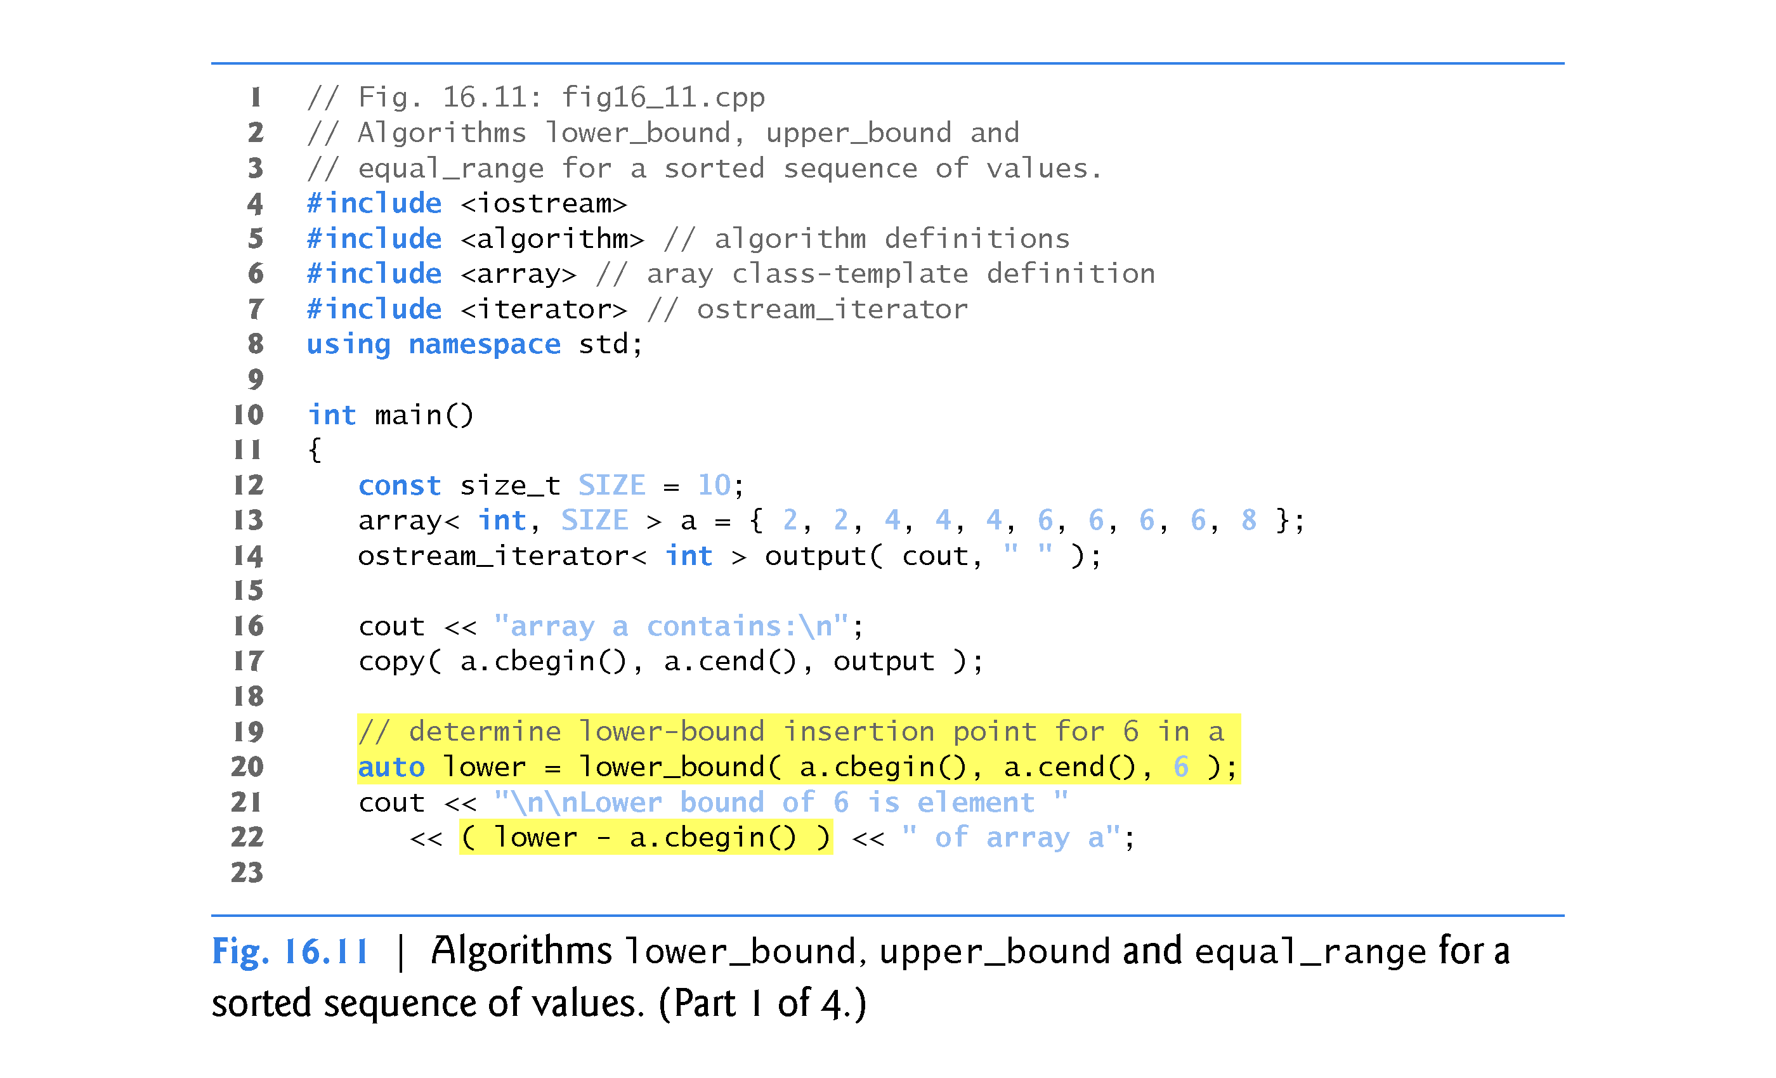

Slide 138
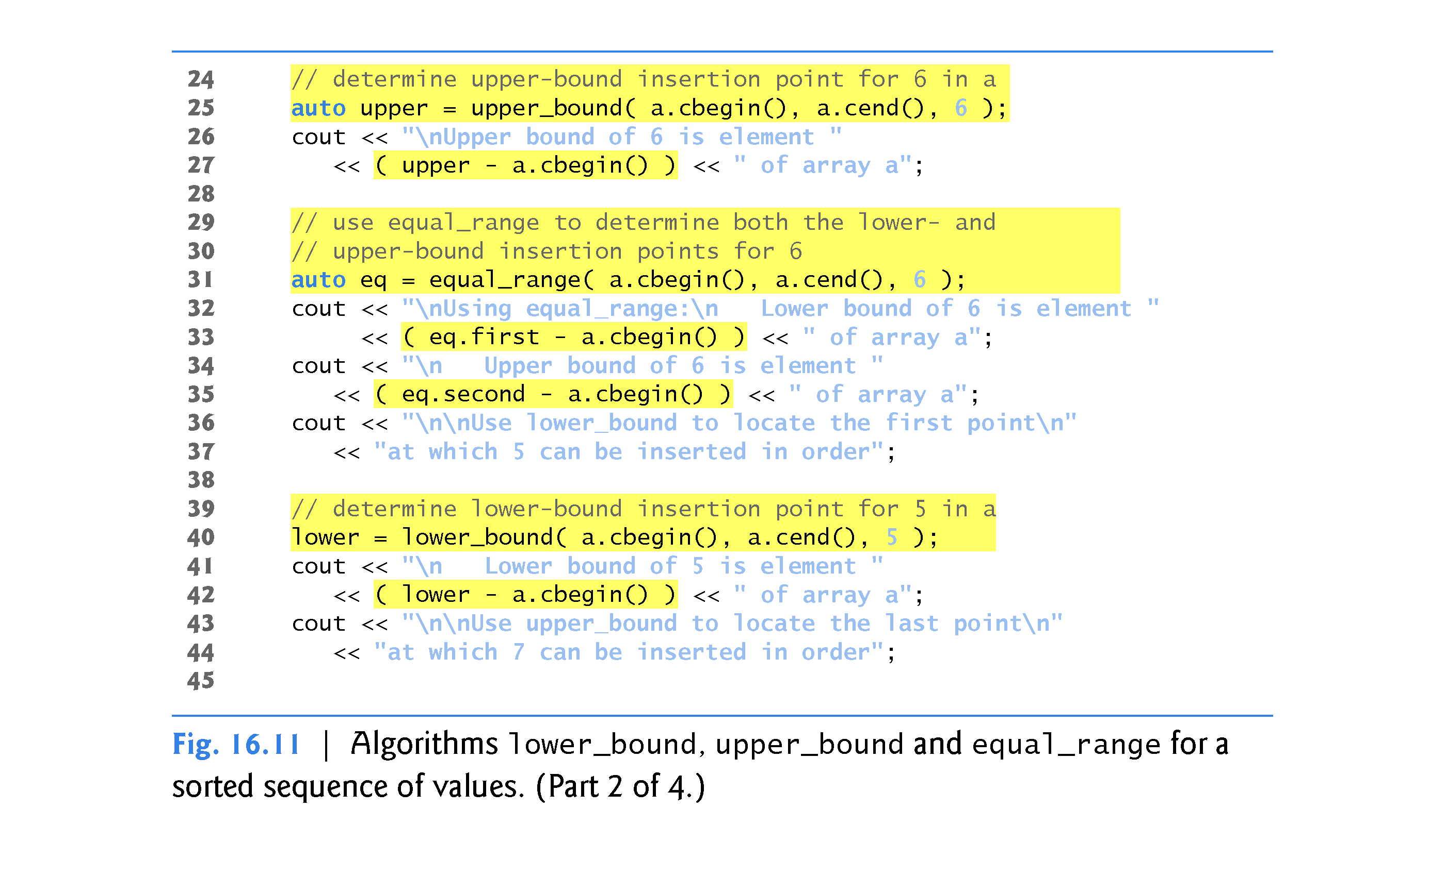

Slide 139
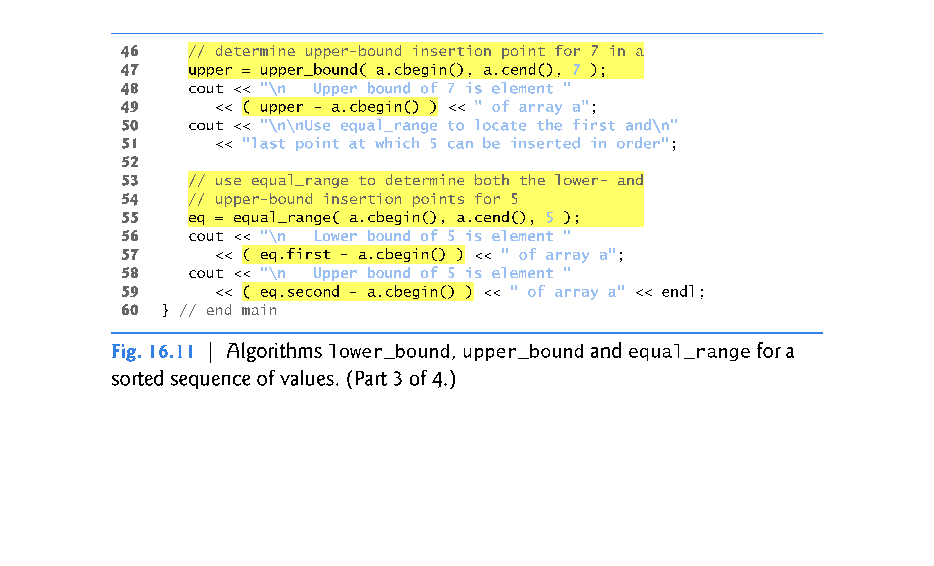

Slide 140


Slide 141
16.3.11 lower_bound, upper_bound and equal_range (cont.)
lower_bound Algorithm
Line 20 uses the lower_bound algorithm to find the first location in a sorted sequence of values at which the third argument could be inserted in the sequence such that the sequence would still be sorted in ascending order.
The first two iterator arguments must be at least forward iterators.
The third argument is the value for which to determine the lower bound.

Slide 142
16.3.11 lower_bound, upper_bound and equal_range (Cont.)
The algorithm returns a forward iterator pointing to the position at which the insert can occur.
A second version of lower_bound takes as a fourth argument a binary predicate function indicating the order in which the elements were originally sorted.

Slide 143
16.3.11 lower_bound, upper_bound and equal_range (Cont.)
upper_bound Algorithm
Line 25 uses the upper_bound algorithm to find the last location in a sorted sequence of values at which the third argument could be inserted in the sequence such that the sequence would still be sorted in ascending order.
The first two iterator arguments must be at least forward iterators.
The third argument is the value for which to determine the upper bound.
The algorithm returns a forward iterator pointing to the position at which the insert can occur.
A second version of upper_bound takes as a fourth argument a binary predicate function indicating the order in which the elements were originally sorted.

Slide 144
16.3.11 lower_bound, upper_bound and equal_range (Cont.)
equal_range Algorithm
Line 31 uses the equal_range algorithm to return a pair of forward iterators containing the results of performing both a lower_bound and an upper_bound operation.
The first two arguments must be at least forward iterators.
The third is the value for which to locate the equal range.
The algorithm returns a pair of forward iterators for the lower bound (eq.first) and upper bound (eq.second), respectively.

Slide 145
16.3.11 lower_bound, upper_bound and equal_range (Cont.)
Locating Insertion Points in Sorted Sequences
Algorithms lower_bound, upper_bound and equal_range are often used to locate insertion points in sorted sequences.
Line 40 uses lower_bound to locate the first point at which 5 can be inserted in order in a.
Line 47 uses upper_bound to locate the last point at which 7 can be inserted in order in a.
Line 55 uses equal_range to locate the first and last points at which 5 can be inserted in order in a.

Slide 146
16.3.12 Heapsort
Figure 16.12 demonstrates the Standard Library algorithms for performing the heapsort sorting algorithm, in which an array of elements is arranged into a data structure called a heap.
Heapsort is discussed in detail in computer science courses called “Data Structures” and “Algorithms.”

Slide 147


Slide 148


Slide 149


Slide 150


Slide 151


Slide 152
16.3.12 Heapsort (Cont.)
make_heap Algorithm
Line 21 uses the make_heap algorithm to take a sequence of values in the range from a.begin() up to, but not including, a.end() and create a heap that can be used to produce a sorted sequence.
The two iterator arguments must be random-access iterators, so this algorithm will work only with arrays, vectors and deques.
A second version of this algorithm takes as a third argument a binary predicate function for comparing values.

Slide 153
16.3.12 Heapsort (Cont.)
sort_heap Algorithm
Line 24 uses the sort_heap algorithm to sort a sequence of values in the range from a.begin() up to, but not including, a.end() that are already arranged in a heap.
The two iterator arguments must be random-access iterators.
A second version of this algorithm takes as a third argument a binary predicate function for comparing values.

Slide 154
16.3.12 Heapsort (Cont.)
push_heap Algorithm
Line 40 uses the push_heap algorithm to add a new value into a heap.
We take one element of array init at a time, append it to the end of vector v and perform the push_heap operation.
If the appended element is the only element in the vector, the vector is already a heap.
Otherwise, push_heap rearranges the vector elements into a heap.

Slide 155
16.3.12 Heapsort (Cont.)
Each time push_heap is called, it assumes that the last element currently in the vector (i.e., the one that is appended before the push_heap call) is the element being added to the heap and that all other elements in the vector are already arranged as a heap.
The two iterator arguments to push_heap must be random-access iterators.
A second version of this algorithm takes as a third argument a binary predicate function for comparing values.

Slide 156
16.3.12 Heapsort (Cont.)
pop_heap Algorithm
Line 51 uses pop_heap to remove the top heap element.
This algorithm assumes that the elements in the range specified by its two random-access iterator arguments are already a heap.
Repeatedly removing the top heap element results in a sorted sequence of values.
Algorithm pop_heap swaps the first heap element (v.begin()) with the last heap element (the element before v.end() - j), then ensures that the elements up to, but not including, the last element still form a heap.
Notice in the output that, after the pop_heap operations, the vector is sorted in ascending order.
A second version of this algorithm takes as a third argument a binary predicate function for comparing values.

Slide 157
16.3.12 Heapsort (Cont.)
C++11: is_heap and is_heap_until Algorithms
The is_heap algorithm returns true if the elements in the specified range represent a heap.
A second version of this algorithm takes as a third argument a binary predicate function for comparing values.
The is_heap_until algorithm checks the specified range of values and returns an iterator pointing to the last item in the range for which the elements up to, but not including, that iterator represent a heap.

Slide 158
16.3.13 min, max, minmax and minmax_element
Figure 16.13 demonstrates min, max, minmax and minmax_element.

Slide 159


Slide 160


Slide 161
16.3.13 min, max, minmax and minmax_element (cont.)
Algorithms min and max (demonstrated in lines 10–13) determine the minimum and the maximum of two elements, respectively.

Slide 162
16.3.13 min, max, minmax and minmax_element (cont.)
C++11: min and max Algorithms with initializer_list Parameters
C++11 now includes overloaded versions of the algorithms min and max that each receive an initializer_list parameter and return the smallest or largest item in the list initializer that’s passed as an argument.
For example, the following statement returns 7:
int minumum = min( { 10, 7, 14, 21, 17 } );
Each of these new min and max algorithms is overloaded with a version that takes as a second argument a binary predicate function for comparing values.

Slide 163
16.3.13 min, max, minmax and minmax_element (cont.)
C++11: min_max Element
C++11 now includes the minmax_element algorithm (line 26) that receives two input iterators representing a range of elements and returns a pair of iterators in which first points to the smallest element in the range and second points to the largest.
A second version of this algorithm takes as a third argument a binary predicate function for comparing values.

Slide 164
16.4 Function Objects
Many Standard Library algorithms allow you to pass a function pointer into the algorithm to help the algorithm perform its task.
For example, the binary_search algorithm that we discussed in Section 16.3.6 is overloaded with a version that requires as its fourth parameter a function pointer that takes two arguments and returns a bool value.
The algorithm uses this function to compare the search key to an element in the collection.
The function returns true if the search key and element being compared are equal; otherwise, the function returns false.

Slide 165
16.4 Function Objects (Cont.)
This enables binary_search to search a collection of elements for which the element type does not provide an overloaded equality < operator.
Any algorithm that can receive a function pointer can also receive an object of a class that overloads the function-call operator (parentheses) with a function named operator(), provided that the overloaded operator meets the requirements of the algorithm—in the case of binary_search, it must receive two arguments and return a bool.

Slide 166
16.4 Function Objects (Cont.)
An object of such a class is known as a function object and can be used syntactically and semantically like a function or function pointer—the overloaded parentheses operator is invoked by using a function object’s name followed by parentheses containing the arguments to the function.
Most algorithms can use function objects and functions interchangeably.

Slide 167
16.4 Function Objects (Cont.)
Advantages of Function Objects Over Function Pointers
Function objects provide several advantages over function pointers.
The compiler can inline a function object’s overloaded operator() to improve performance.
Also, since they’re objects of classes, function objects can have data members that operator() can use to perform its task.

Slide 168
16.4 Function Objects (Cont.)
Predefined Function Objects of the Standard Template Library
Many predefined function objects can be found in the header <functional>.
Figure 16.14 lists several of the dozens of Standard Library function objects, which are all implemented as class templates.
We used the function object less< T > in the set, multiset and priority_queue examples, to specify the sorting order for elements in a container.

Slide 169


Slide 170
16.4 Function Objects (Cont.)
Using the accumulate Algorithm
Figure 16.15 uses the accumulate numeric algorithm (introduced in Fig. 16.30) to calculate the sum of the squares of the elements in an array.
The fourth argument to accumulate is a binary function object (that is, a function object for which operator() takes two arguments) or a function pointer to a binary function (that is, a function that takes two arguments).
Function accumulate is demonstrated twice—once with a function pointer and once with a function object.

Slide 171


Slide 172


Slide 173


Slide 174


Slide 175
16.4 Function Objects (Cont.)
Function sumSquares
Lines 13–16 define a function sumSquares that squares its second argument value, adds that square and its first argument total and returns the sum.
Function accumulate will pass each of the elements of the sequence over which it iterates as the second argument to sumSquares in the example.
On the first call to sumSquares, the first argument will be the initial value of the total (which is supplied as the third argument to accumulate; 0 in this program).
All subsequent calls to sumSquares receive as the first argument the running sum returned by the previous call to sumSquares.
When accumulate completes, it returns the sum of the squares of all the elements in the sequence.

Slide 176
16.4 Function Objects (Cont.)
Class SumSquaresClass
Lines 21–30 define SumSquaresClass with an overloaded operator() that has two parameters and returns a value—the requirements for a binary function object.
On the first call to the function object, the first argument will be the initial value of the total (which is supplied as the third argument to accumulate; 0 in this program) and the second argument will be the first element in array integers.
All subsequent calls to operator receive as the first argument the result returned by the previous call to the function object, and the second argument will be the next element in the array.
When accumulate completes, it returns the sum of the squares of all the elements in the array.

Slide 177
16.4 Function Objects (Cont.)
Passing Function Pointers and Function Objects to Algorithm accumulate
Lines 43–44 call function accumulate with a pointer to function sumSquares as its last argument.
Similarly, the statement in lines 51–52 calls accumulate with an object of class SumSquaresClass as the last argument.
The expression SumSquaresClass< int >() creates (and calls the default constructor for) an instance of class SumSquaresClass (a function object) that is passed to accumulate, which invokes function operator().

Slide 178
16.4 Function Objects (Cont.)
Lines 51-52 could be written as two separate statements, as follows:
SumSquaresClass< int > sumSquaresObject; result = accumulate( integers.cbegin(), integers.cend(), 0, sumSquaresObject );
The first line defines an object of class SumSquaresClass.
That object is then passed to function accumulate.

Slide 179
16.5 Lambda Expressions
Before you can pass a function pointer or function object to an algorithm, the corresponding function or class must have been declared.
C++11’s Lambda expressions (or lambda functions) enable you to define anonymous function objects where they’re passed to a function.
They’re defined locally inside functions and can “capture” (by value or by reference) the local variables of the enclosing function then manipulate these variables in the lambda’s body.
Figure 16.16 demonstrates a simple lambda expression example that doubles the value of each element in an int array.

Slide 180


Slide 181


Slide 182
16.5 Lambda Expressions (cont.)
Lines 10 and 11 declare and initialize a small array of ints named values.
Lines 14–15 call the for_each algorithm on the elements of values.
The third argument (line 15) to for_each is a lambda expression.
Lambdas begin with lambda introducer ([]), followed by a parameter list and function body.
Return types can be inferred automatically if the body is a single statement of the form return expression;—otherwise, the return type is void by default or you can explicitly use a trailing return type.
The compiler converts the lambda expression into a function object. The lambda expression in line 15 receives an int, multiplies it by 2 and displays the result.
The for_each algorithm passes each element of the array to the lambda.

Slide 183
16.5 Lambda Expressions (cont.)
The second call to the for_each algorithm (lines 20–21) calculates the sum of the array elements.
The lambda introducer [&sum] indicates that this lambda expression captures the local variable sum by reference (note the use of the ampersand), so that the lambda can modify sum’s value.
Without the ampersand, sum would be captured by value and the local variable outside the lambda expression would not be updated.
The for_each algorithm passes each element of values to the lambda, which adds the value to the sum. Line 23 then displays the value of sum.

Slide 184
16.5 Lambda Expressions (cont.)
You can assign lambda expressions to variables, which can then be used to invoke the lambda expression or pass it to other functions.
For example, you can assign the lambda expression in line 15 to a variable as follows:
auto myLambda = []( int i ) { cout << i * 2 << endl; };
You can then use the variable name as a function name to invoke the lambda as in:
myLambda( 10 ); // outputs 20

Slide 185
16.6 Standard Library Algorithm Summary
The C++ standard specifies over 90 algorithms—many overloaded with two or more versions.
The standard separates the algorithms into several categories
mutating sequence algorithms
nonmodifying sequence algorithms
sorting and related algorithms
generalized numeric operations.
To learn about the algorithms that we did not present in this chapter, see your compiler’s documentation or visit sites such as
en.cppreference.com/w/cpp/algorithm

Slide 186
16.6 Standard Library Algorithm Summary (cont.)
Mutating Sequence Algorithms
Figure 16.17 shows many of the mutating-sequence algorithms—i.e., algorithms that modify the containers they operate on.
Algorithms new in C++11 are marked with an * in Figs. 16.17–16.20.
Algorithms presented in this chapter are shown in bold.

Slide 187


Slide 188
16.6 Standard Library Algorithm Summary (cont.)
Nonmodifying Sequence Algorithms
Figure 16.18 shows the nonmodifying sequence algorithms—i.e., algorithms that do not modify the containers they operate on.

Slide 189


Slide 190
16.6 Standard Library Algorithm Summary (cont.)
Sorting and Related Algorithms
Figure 16.19 shows the sorting and related algorithms.

Slide 191


Slide 192
16.6 Standard Library Algorithm Summary (cont.)
Numerical Algorithms
Figure 16.20 shows the numerical algorithms of the header <numeric>.

Slide 193


